Slide 1
Summary

Slide 2
Requisite prior knowledge for this activity
Sketching the gradient function of a curve
Identifying stationary points
Classifying stationary points

Slide 3
Learning Objective
Summarise knowledge of
  Sketching gradient functions
  Identifying stationary points
  Classifying stationary points
  Second derivative
Use this knowledge to sketch gradient functions given an original function

Slide 4
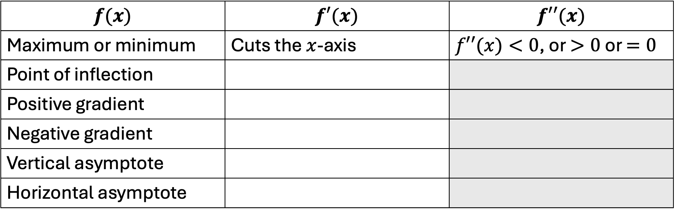
Using the features of a function to sketch the gradient function
Complete the table below, then check using the GeoGebra files on the next slide
$$f(x)$$ | $$f′(x)$$ | $$f′′(x)$$
Maximum or minimum | Cuts the $x$-axis | $f′′(x)<0$, or $>0$ or $=0$
Point of inflection
Positive gradient
Negative gradient
Vertical asymptote
Horizontal asymptote

Slide 5
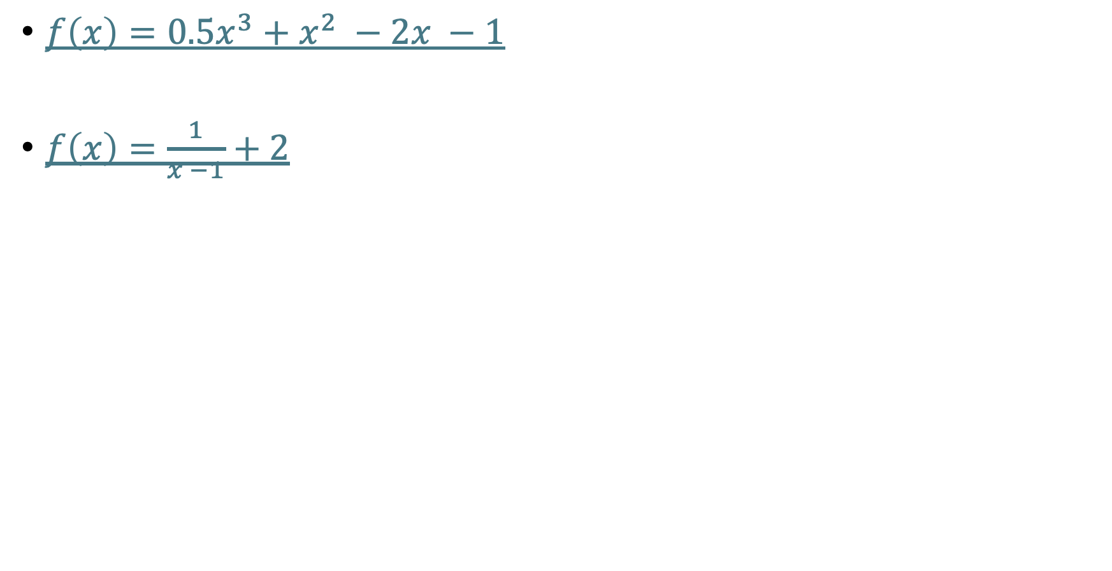
Using the features of a function to sketch the gradient function
$f\left(x\right)=0.5x^{3}+x^{2} −2x −1$
$f\left(x\right)=\frac{1}{x −1}+2$

Slide 6
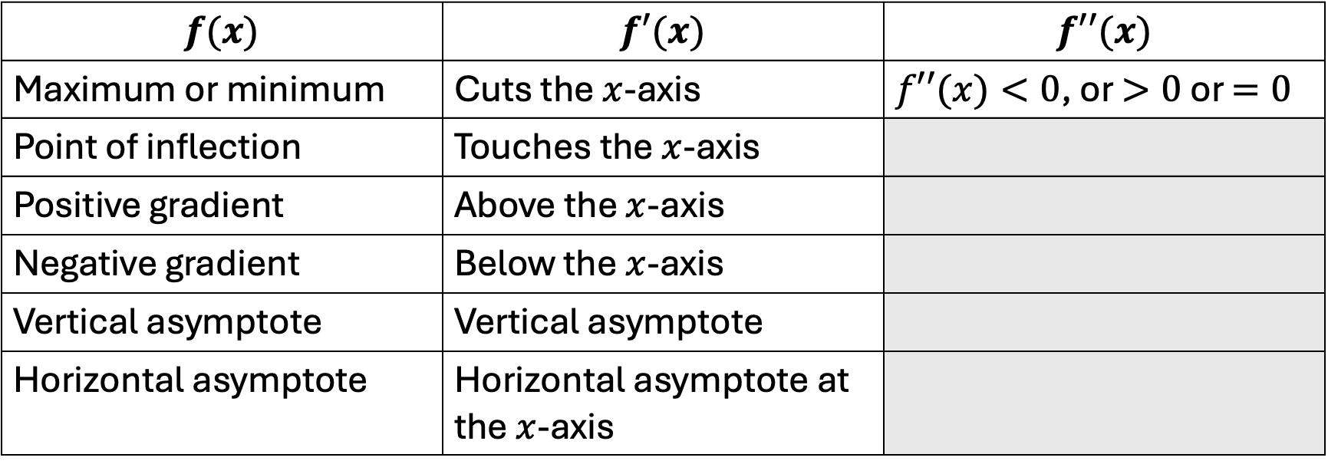
Using the features of a function to sketch the gradient function
Summary
$$f(x)$$ | $$f′(x)$$ | $$f′′(x)$$
Maximum or minimum | Cuts the $x$-axis | $f′′(x)<0$, or $>0$ or $=0$
Point of inflection | Touches the $x$-axis
Positive gradient | Above the $x$-axis
Negative gradient | Below the $x$-axis
Vertical asymptote | Vertical asymptote
Horizontal asymptote | Horizontal asymptote at the $x$-axis

Slide 7
Suggestions for ‘what next’
Fluency practice
Modelling with differentiation (GeoGebra)

