Slide 1
Classifying stationary points

Slide 2
Requisite prior knowledge for this activity
Sketching the gradient function of a curve
Identifying stationary points

Slide 3
Learning Objective
Classify stationary points by examining the graph of the gradient function
Classify stationary points by considering the rate of change of the gradient function

Slide 4
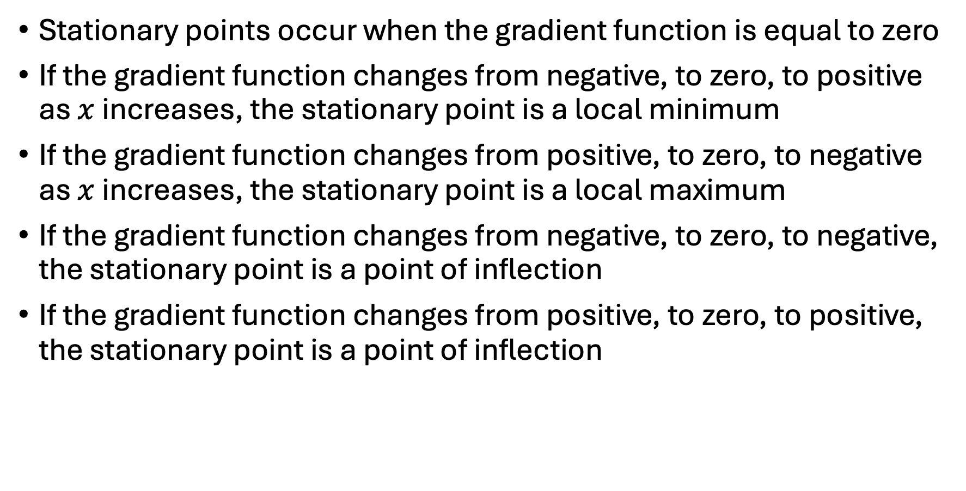
Classifying stationary points from the graph of the gradient function
Stationary points occur when the gradient function is equal to zero
If the gradient function changes from negative, to zero, to positive as $x$ increases, the stationary point is a local minimum
If the gradient function changes from positive, to zero, to negative as $x$ increases, the stationary point is a local maximum
If the gradient function changes from negative, to zero, to negative, the stationary point is a point of inflection
If the gradient function changes from positive, to zero, to positive, the stationary point is a point of inflection

Slide 5
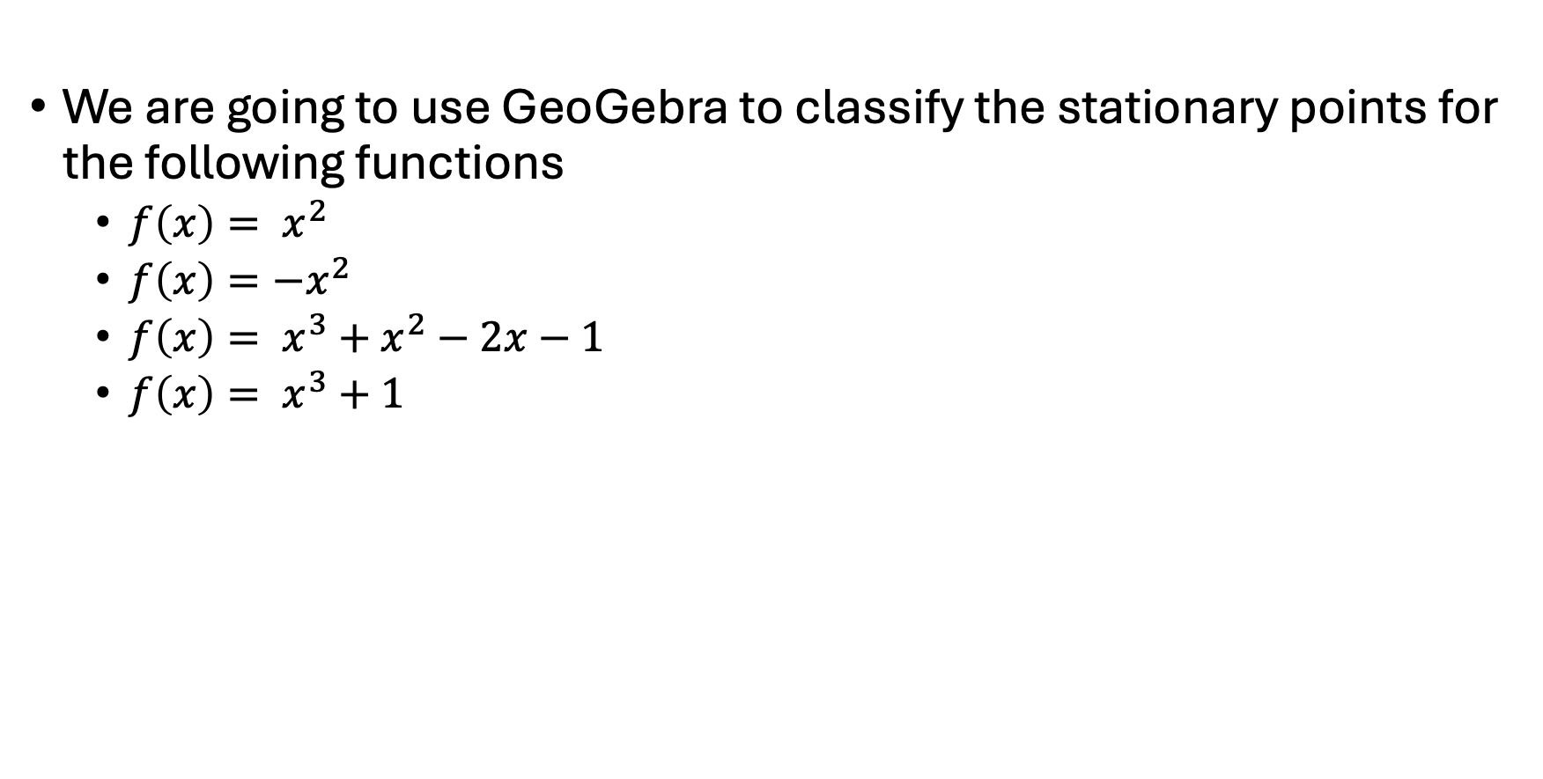
Using GeoGebra to classify stationary points from the graph of the gradient function
We are going to use GeoGebra to classify the stationary points for the following functions
  $f\left(x\right)= x^{2}$
  $f\left(x\right)=−x^{2}$
  $f\left(x\right)= x^{3}+x^{2}−2x−1$
  $f\left(x\right)= x^{3}+1$

Slide 6
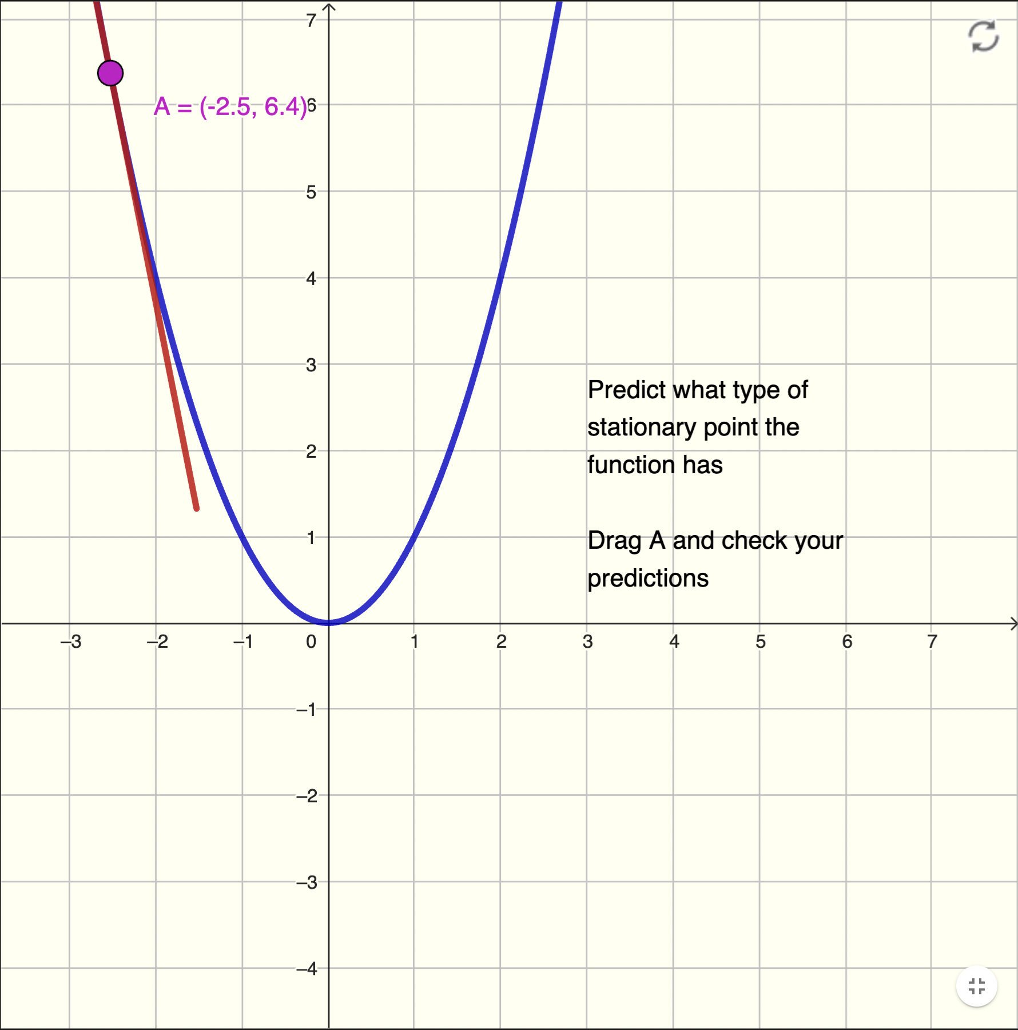
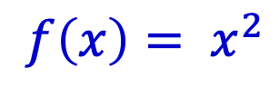
Using GeoGebra
$$f\left(x\right)= x^{2}$$
Reset
We are going to classify stationary points by considering how the gradient function changes
Predict what type of stationary point each graph has
Drag point A to check your predictions
Drag
point A
Tangent
at point A

Slide 7
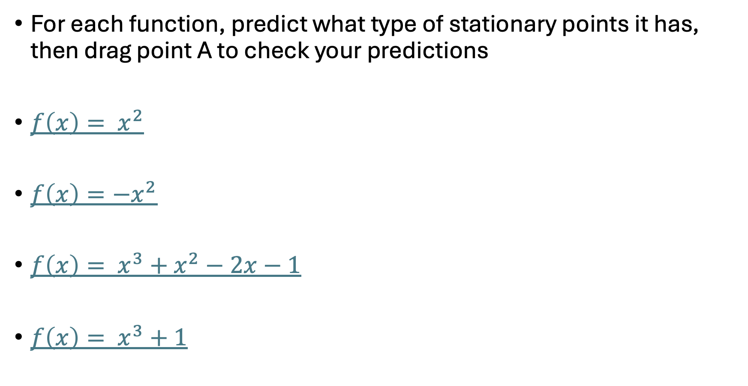
Using GeoGebra to classify stationary points from the graph of the gradient function
For each function, predict what type of stationary points it has, then drag point A to check your predictions
$f\left(x\right)= x^{2}$
$f\left(x\right)=−x^{2}$
$f\left(x\right)= x^{3}+x^{2}−2x−1$
$f\left(x\right)= x^{3}+1$

Slide 8
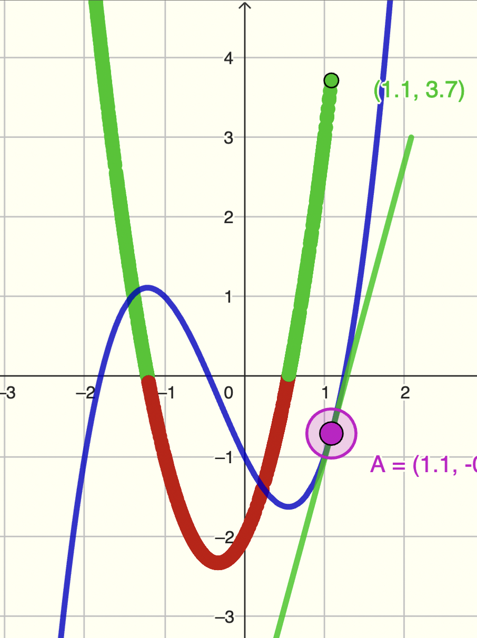
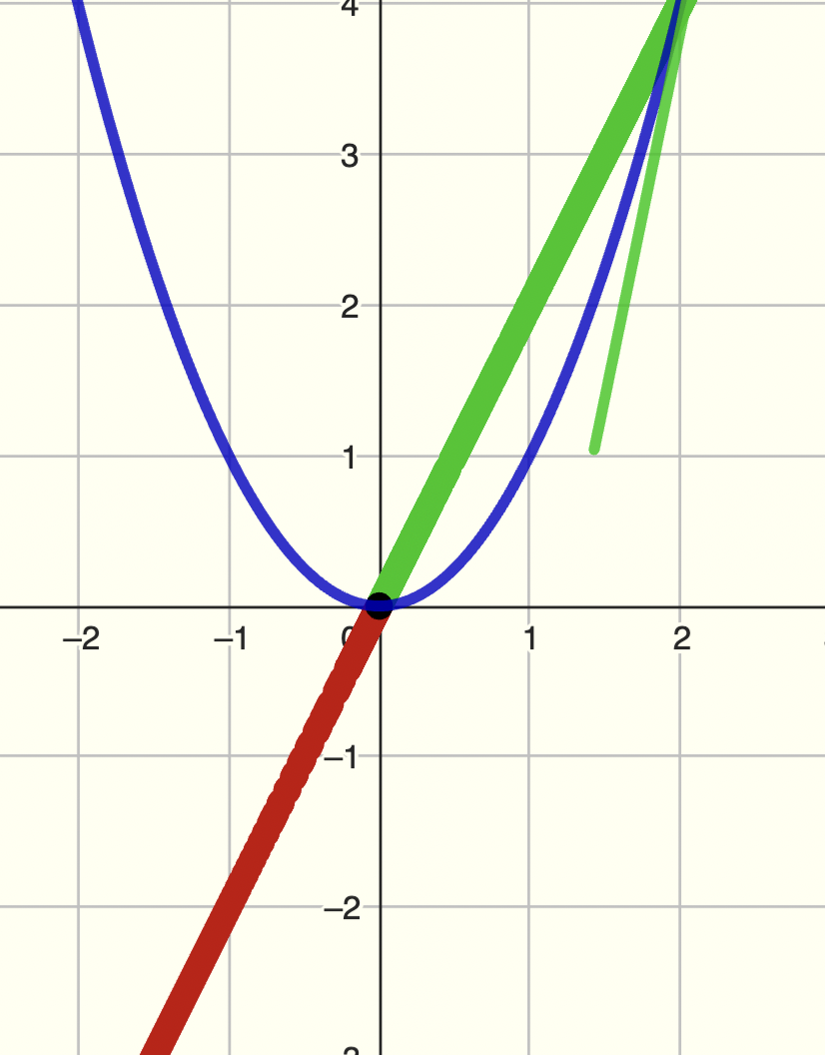
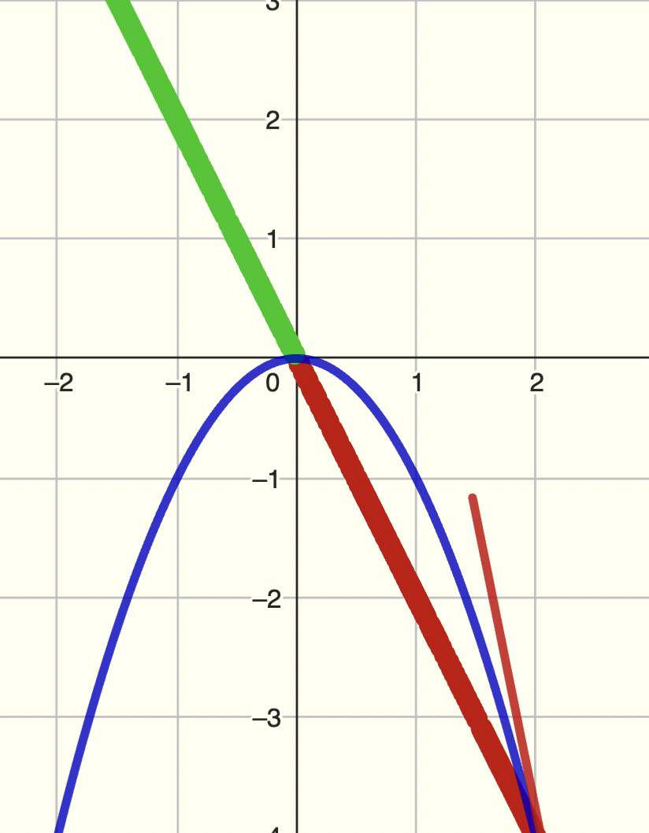
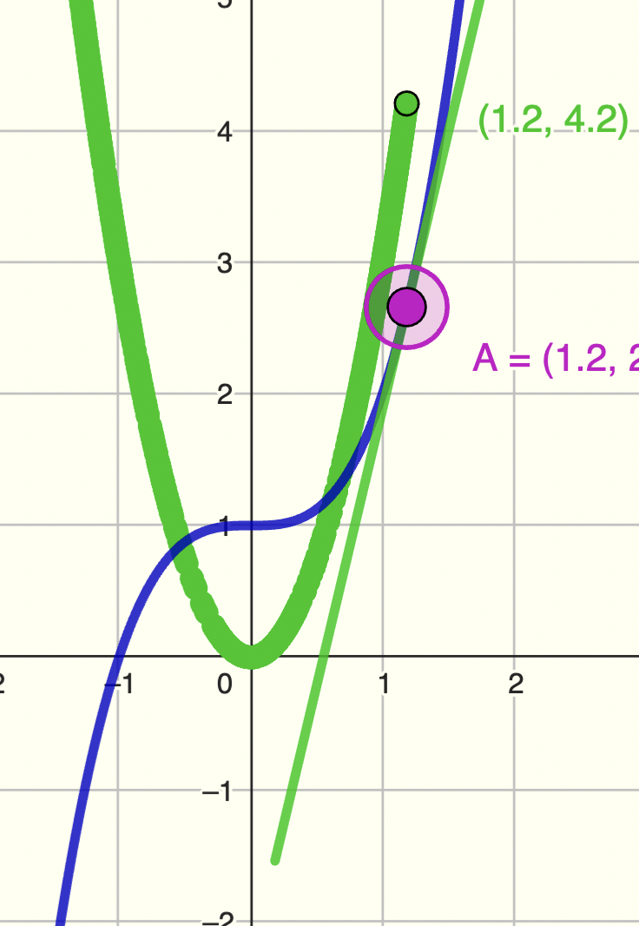
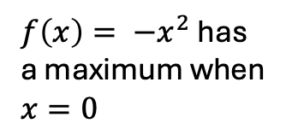
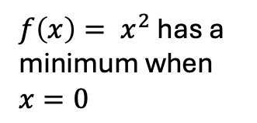
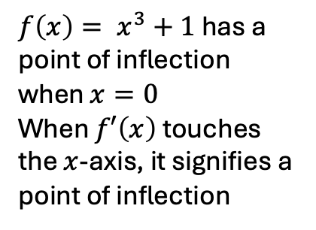
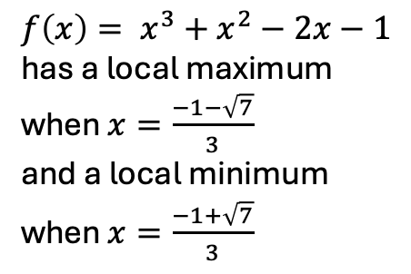
What type of stationary point(s) do the functions have?
$f\left(x\right)= x^{2}$ has a minimum when $x=0$
$f\left(x\right)= {−x}^{2}$ has a maximum when $x=0$
$f\left(x\right)= x^{3}+x^{2}−2x−1$ has a local maximum when $x=\frac{−1−\sqrt{7}}{3}$
and a local minimum when $x=\frac{−1+\sqrt{7}}{3}$
$f\left(x\right)= x^{3}+1$ has a point of inflection when $x=0$
When $f′\left(x\right)$ touches the $x$-axis, it signifies a point of inflection

Slide 9
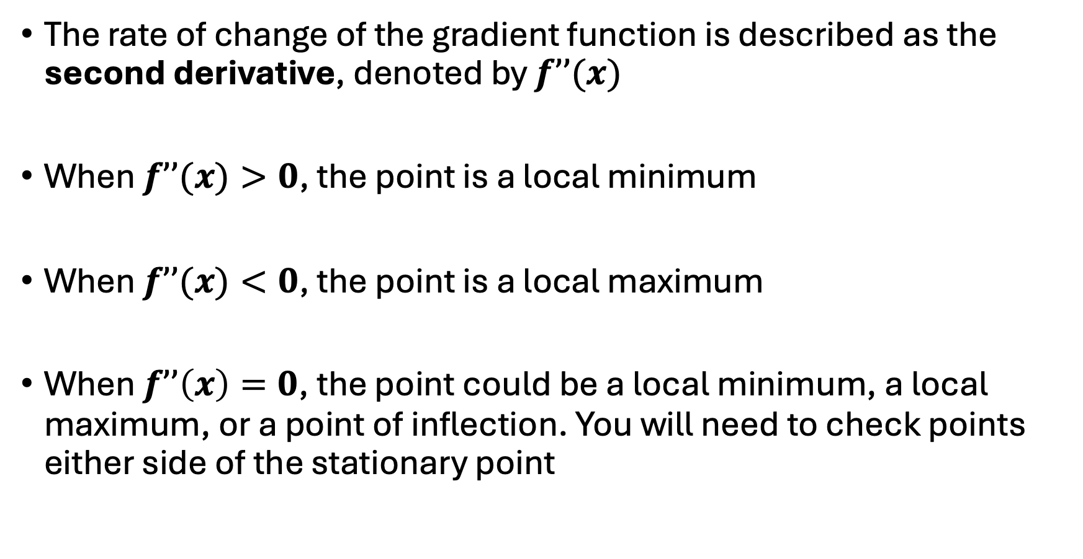
Classifying stationary points by considering the rate of change of the gradient function
The rate of change of the gradient function is described as the second derivative, denoted by $f’’(x)$
When $f’’(x)>0$, the point is a local minimum
When $f’’(x)<0$, the point is a local maximum
When $f’’\left(x\right)=0$, the point could be a local minimum, a local maximum, or a point of inflection. You will need to check points either side of the stationary point

Slide 10
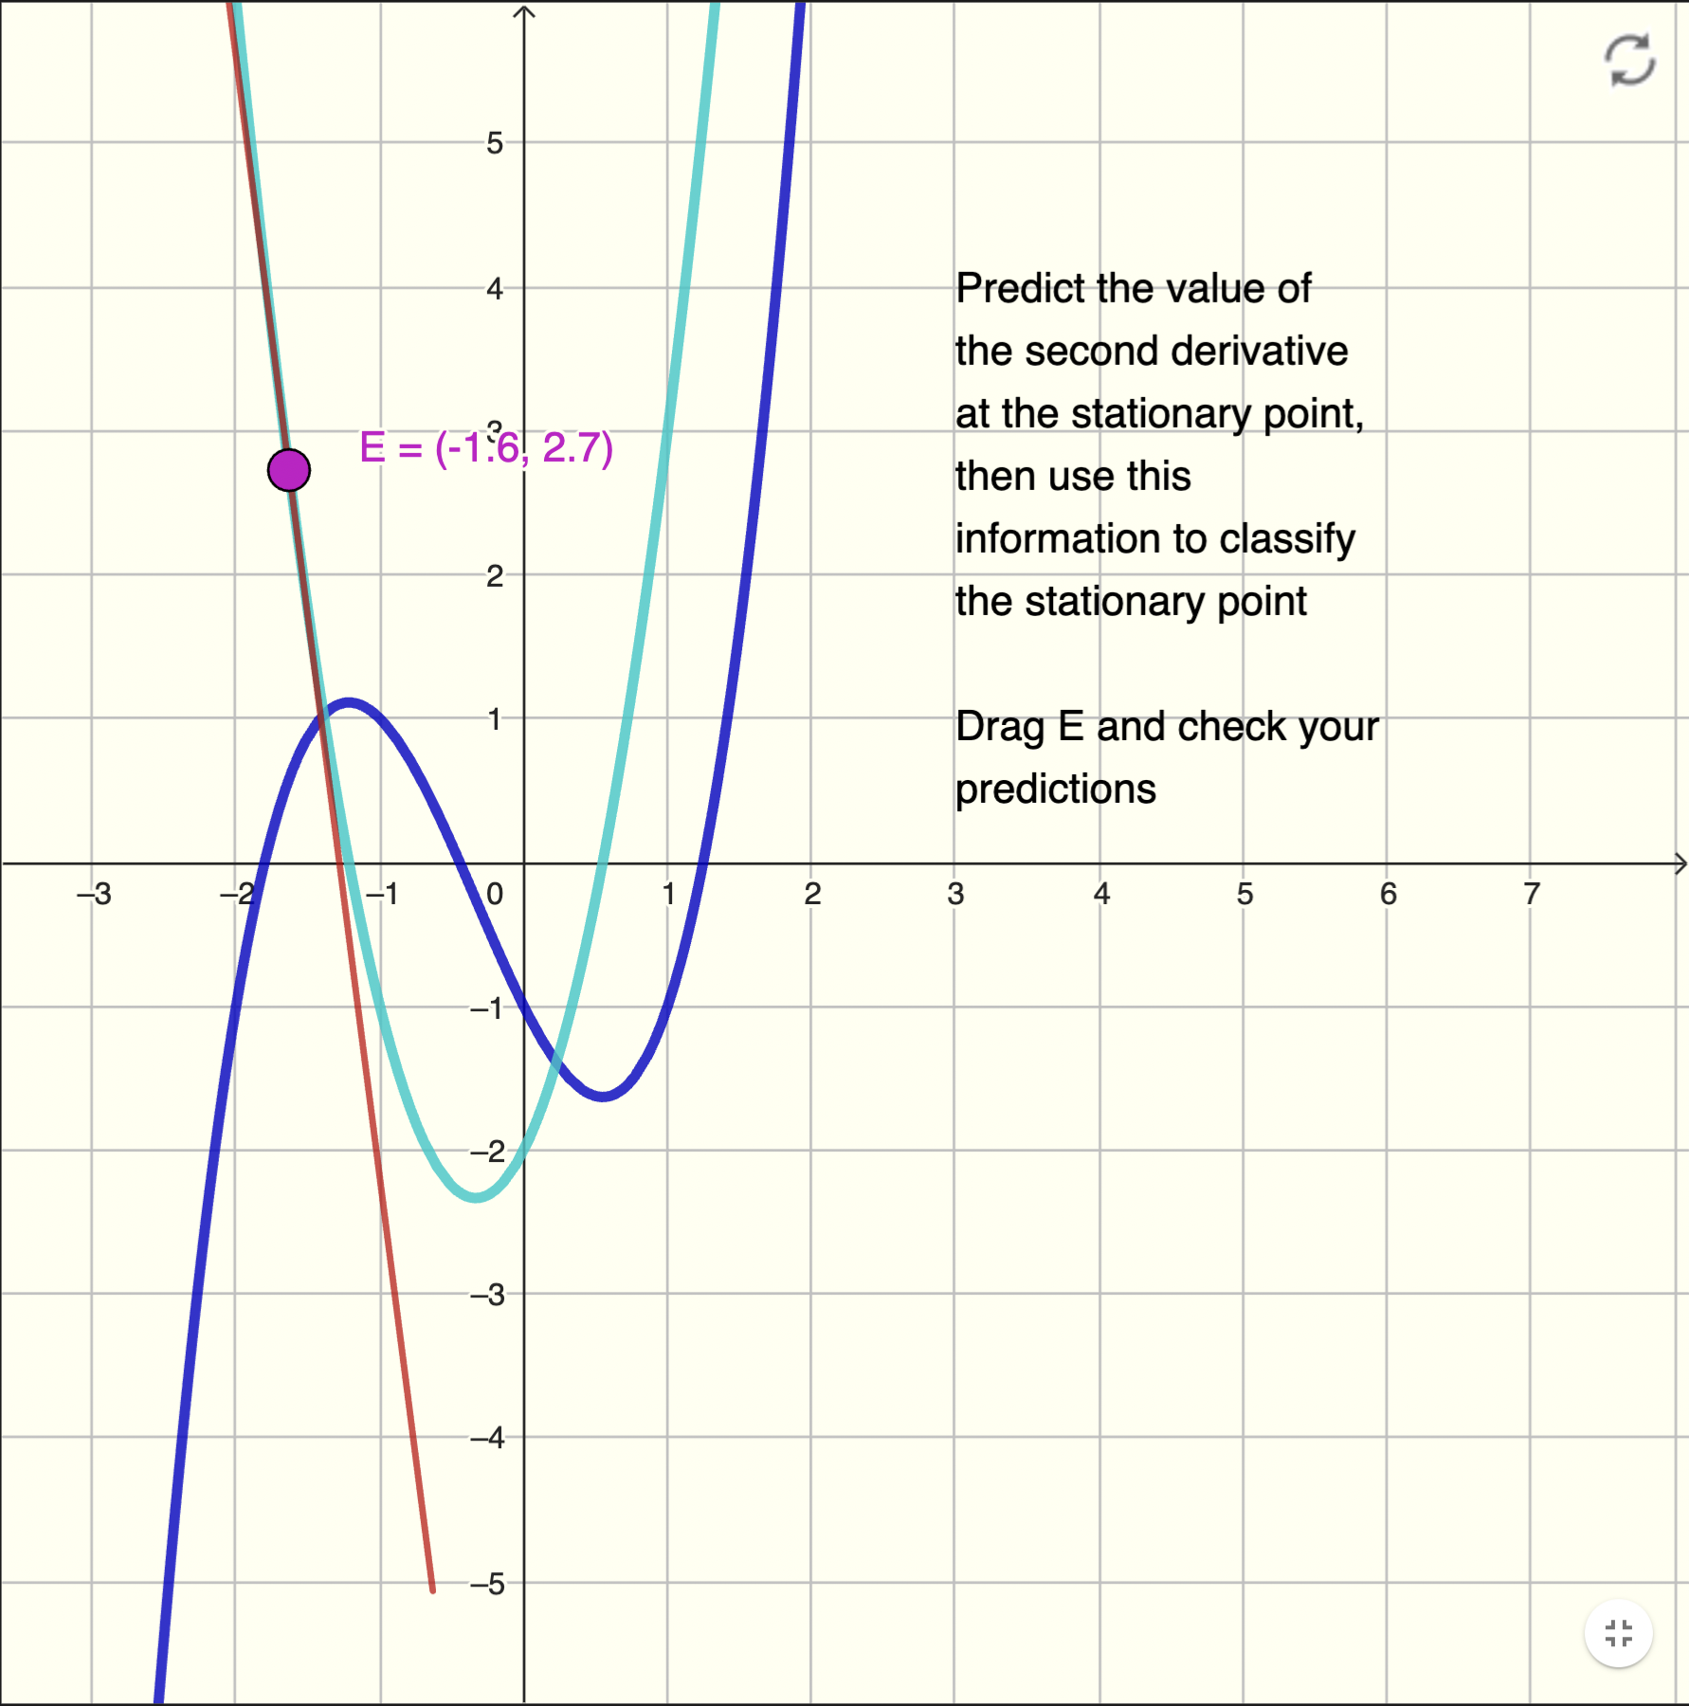

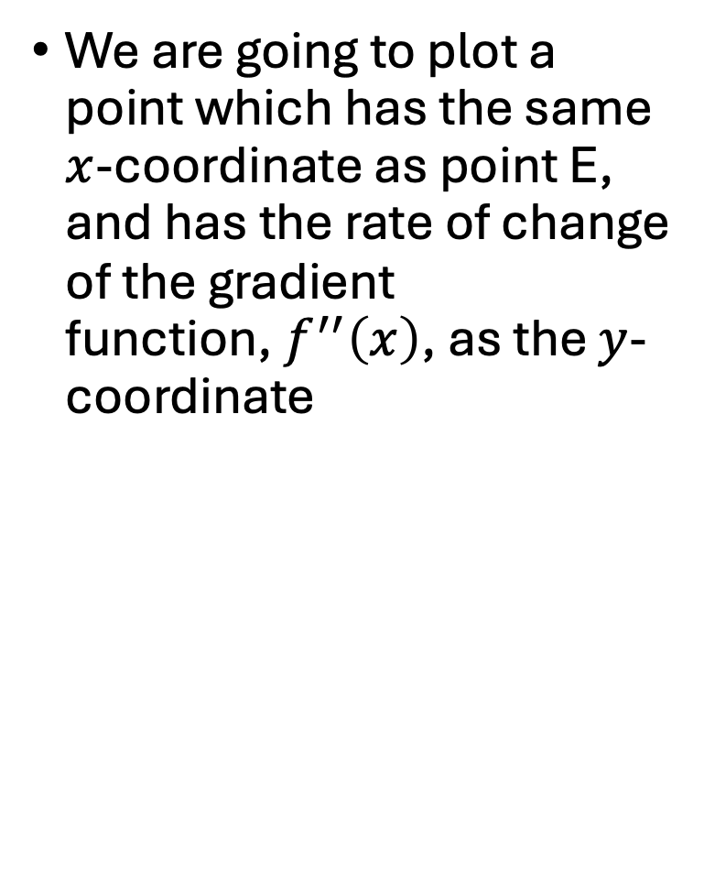
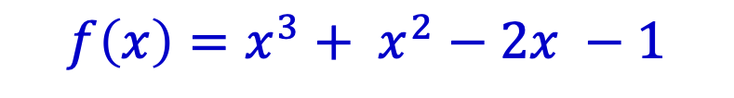
Using GeoGebra
$${ f}^{′}\left(x\right)={3x}^{2}+2x −2$$
$$f\left(x\right)=x^{3}+ x^{2}−2x −1$$
We are going to plot a point which has the same $x$-coordinate as point E, and has the rate of change of the gradient function,${ f}^{′′}\left(x\right)$, as the $y$-coordinate
Drag
point E
Tangent
at point E
Reset

Slide 11
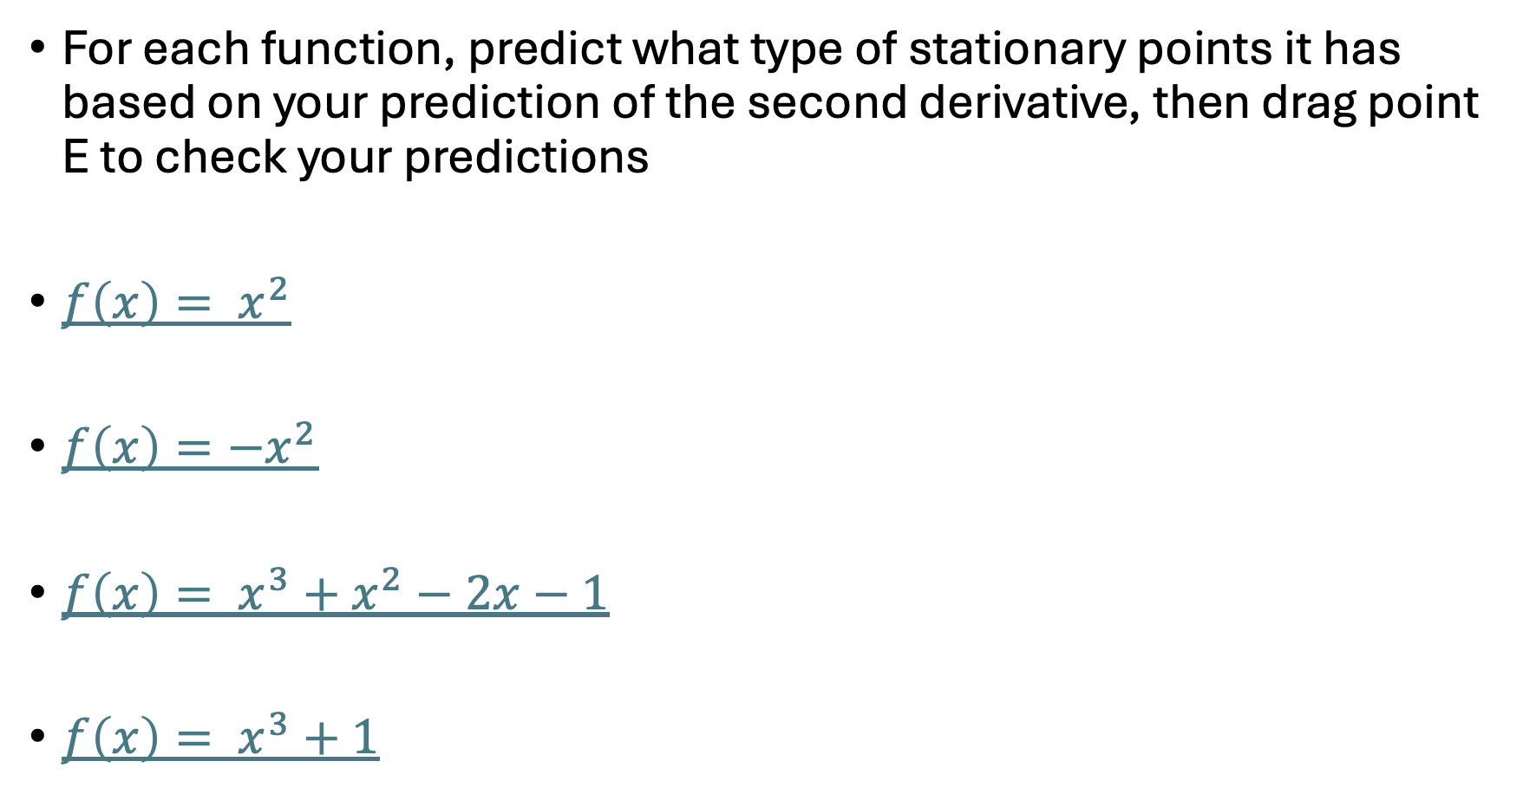
Classifying stationary points using rate of change of the gradient function – i.e., second derivative
For each function, predict what type of stationary points it has based on your prediction of the second derivative, then drag point E to check your predictions
$f\left(x\right)= x^{2}$
$f\left(x\right)=−x^{2}$
$f\left(x\right)= x^{3}+x^{2}−2x−1$
$f\left(x\right)= x^{3}+1$

Slide 12
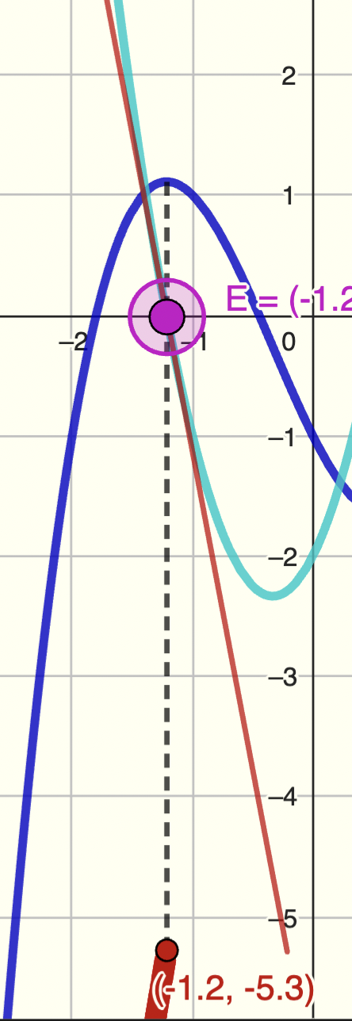
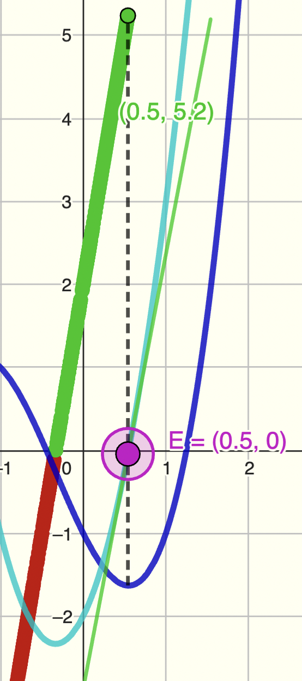
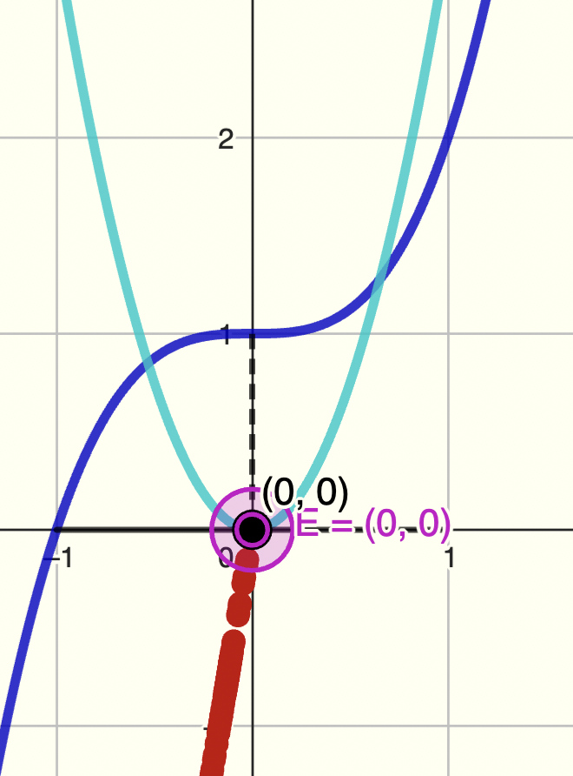
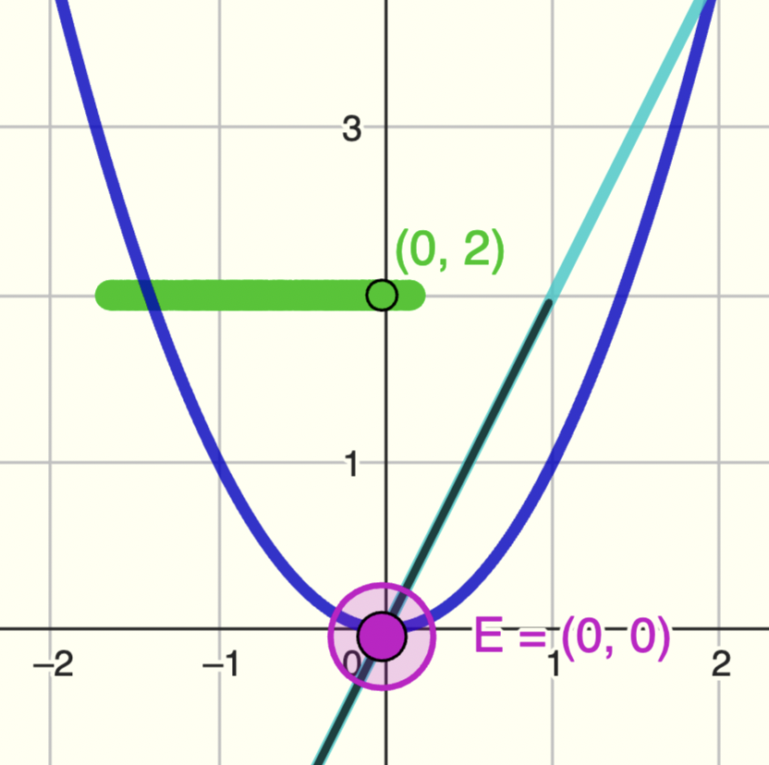
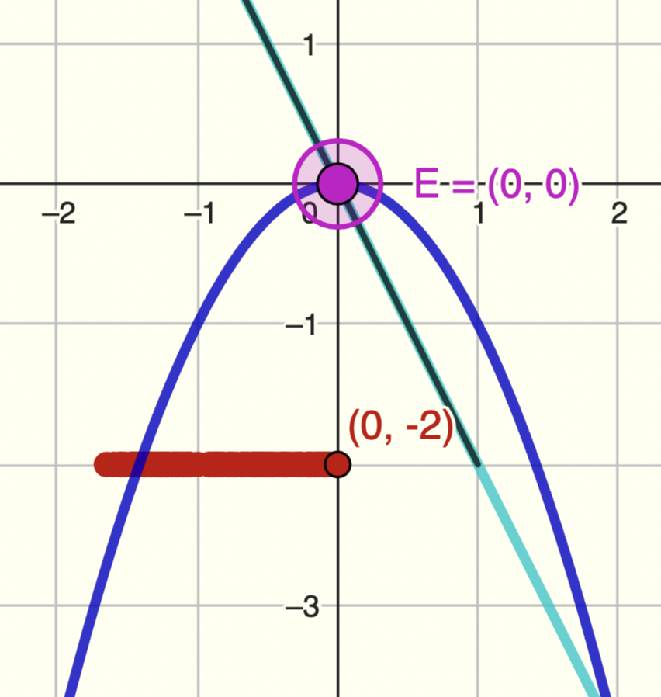
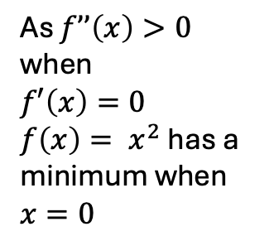
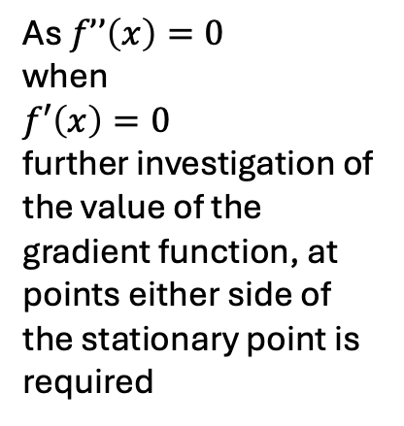
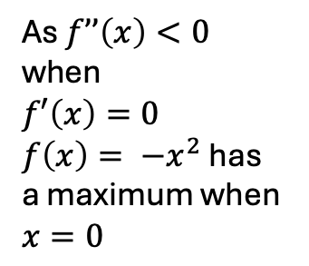
What type of stationary point(s) do the functions have?
$$\text{As} f’’\left(x\right)>0$$
$$\text{when}$$
$$f′\left(x\right)=0$$
$f\left(x\right)= x^{2}$ has a minimum when $x=0$
$$\text{As} f’’\left(x\right)<0$$
$$\text{when}$$
$$f′\left(x\right)=0$$
$f\left(x\right)= {−x}^{2}$ has a maximum when $x=0$
$$\text{As} f’’\left(x\right)=0$$
$$\text{when}$$
$$f′\left(x\right)=0$$
further investigation of the value of the gradient function, at points either side of the stationary point is required
$f\left(x\right)= x^{3}+x^{2}−2x−1$ has a local maximum when $x=\frac{−1−\sqrt{7}}{3}$
and a local minimum when $x=\frac{−1+\sqrt{7}}{3}$

Slide 13
Summary
Stationary points occur when the gradient function is equal to zero
They can be classified by exploring the value of the gradient function either side of the stationary point
They can also be classified by considering the value of the second derivative – i.e., the rate of change of the gradient function – at the stationary point

Slide 14
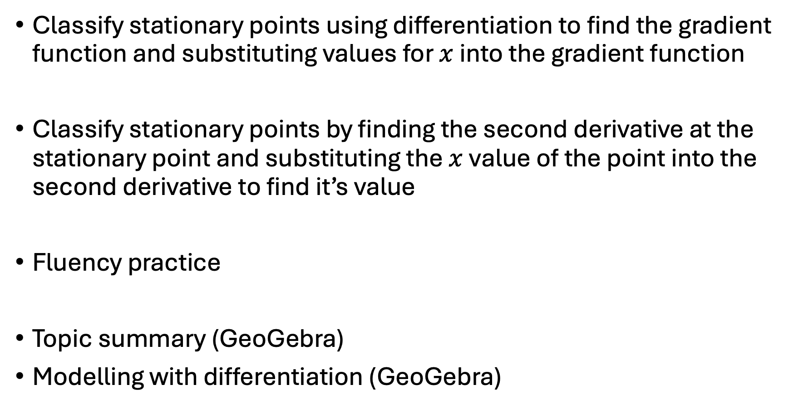
Suggestions for ‘what next’
Classify stationary points using differentiation to find the gradient function and substituting values for $x$ into the gradient function
Classify stationary points by finding the second derivative at the stationary point and substituting the $x$value of the point into the second derivative to find it’s value
Fluency practice
Topic summary (GeoGebra)
Modelling with differentiation (GeoGebra)

