Slide 1
Determining where a function is increasing and decreasing

Slide 2
Requisite prior knowledge for this activity
Sketching the gradient function of a curve
Identifying stationary points

Slide 3
Learning Objective
Determine where a function is increasing and decreasing

Slide 4
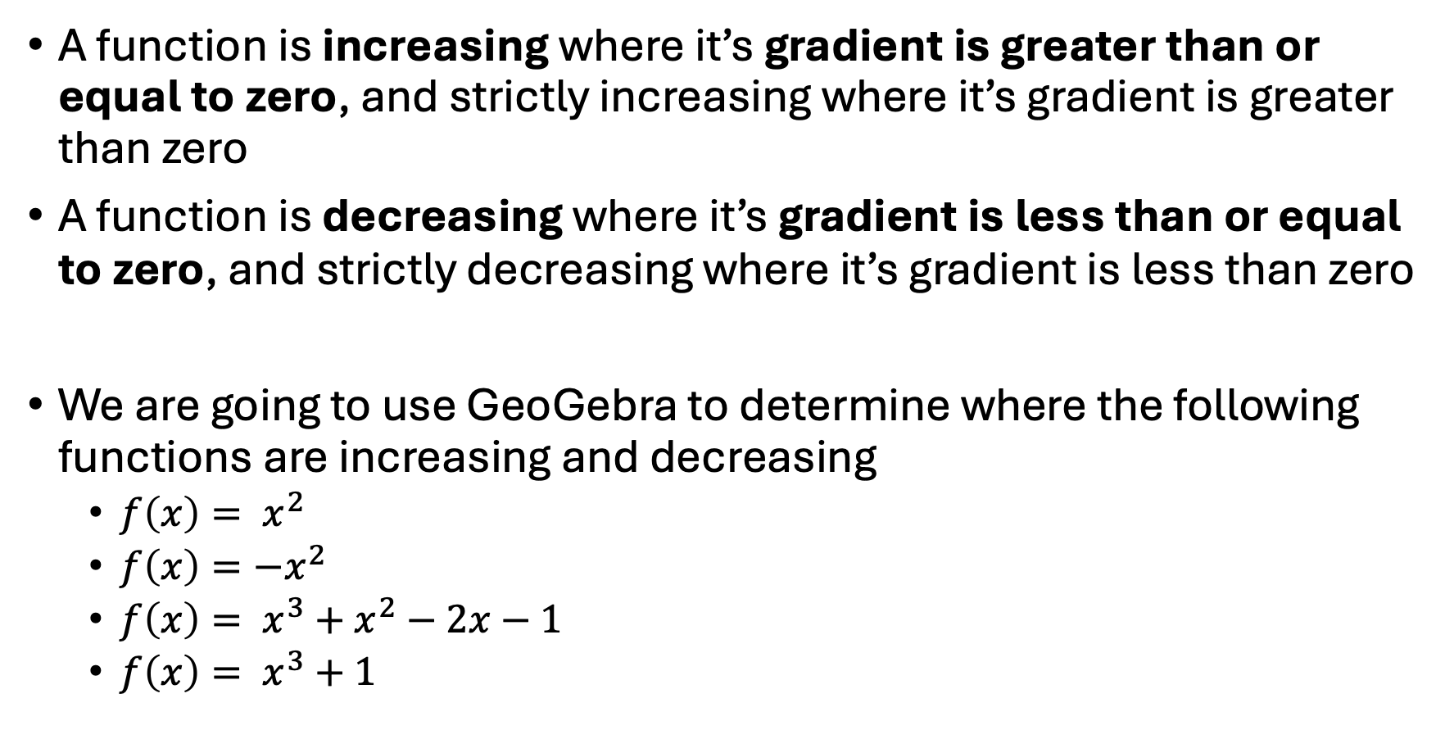
Using GeoGebra to determine where a function is increasing and decreasing
A function is increasing where it’s gradient is greater than or equal to zero, and strictly increasing where it’s gradient is greater than zero
A function is decreasing where it’s gradient is less than or equal to zero, and strictly decreasing where it’s gradient is less than zero
We are going to use GeoGebra to determine where the following functions are increasing and decreasing
  $f\left(x\right)= x^{2}$
  $f\left(x\right)=−x^{2}$
  $f\left(x\right)= x^{3}+x^{2}−2x−1$
  $f\left(x\right)= x^{3}+1$

Slide 5
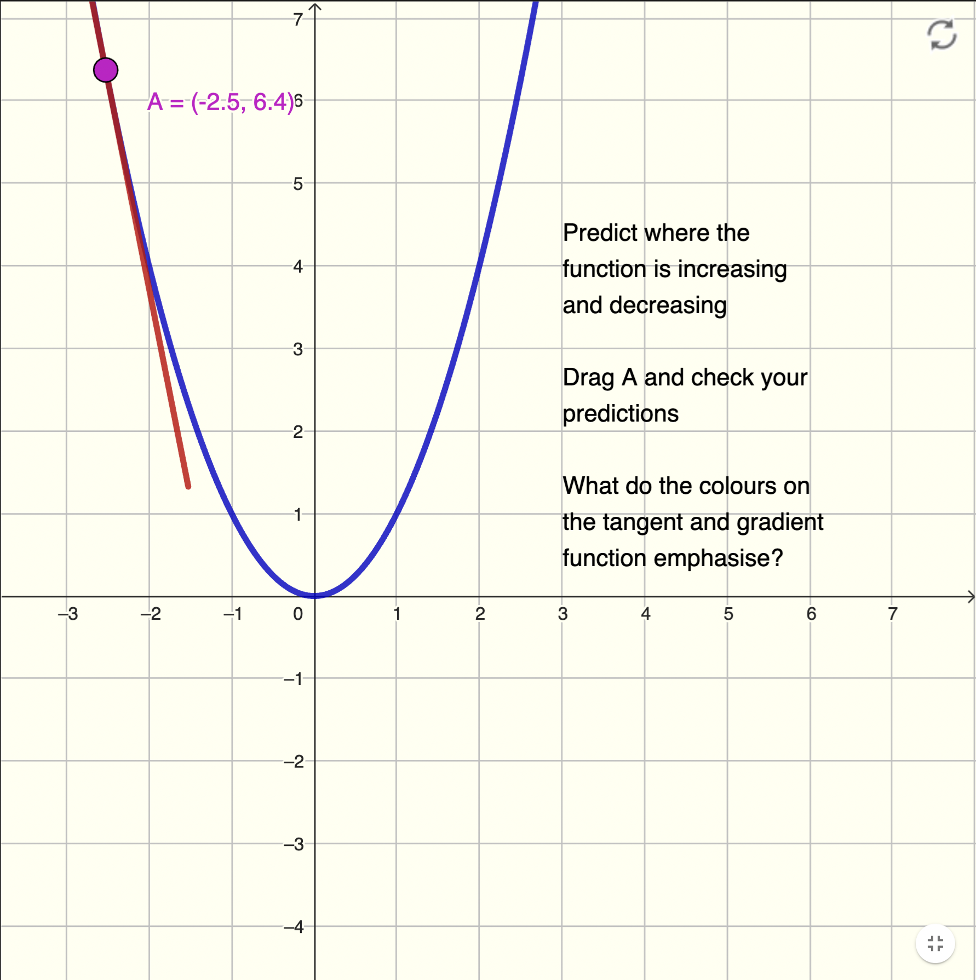
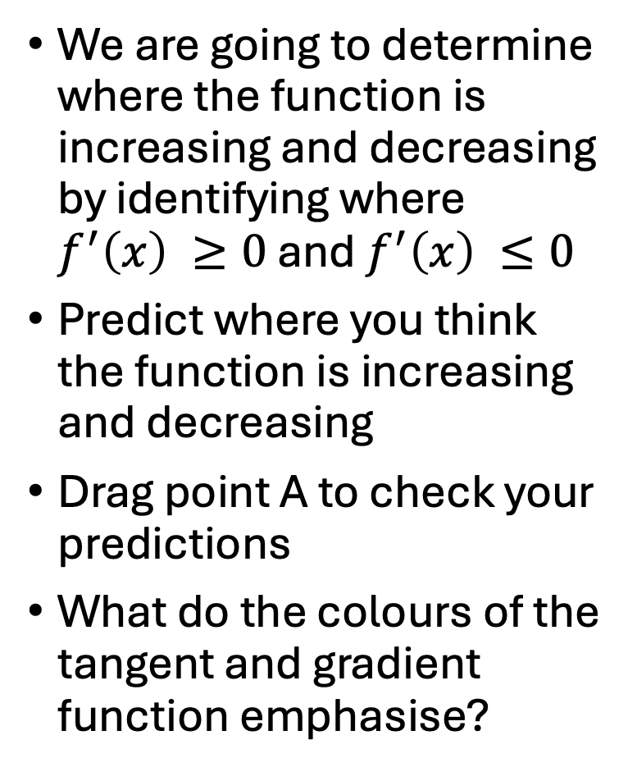
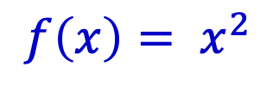
Using GeoGebra
$$f\left(x\right)= x^{2}$$
Reset
We are going to determine where the function is increasing and decreasing by identifying where $f^{′}\left(x\right) ≥0$ and $f^{′}\left(x\right) ≤0$
Predict where you think the function is increasing and decreasing
Drag point A to check your predictions
What do the colours of the tangent and gradient function emphasise?
Drag
point A
Tangent
at point A

Slide 6
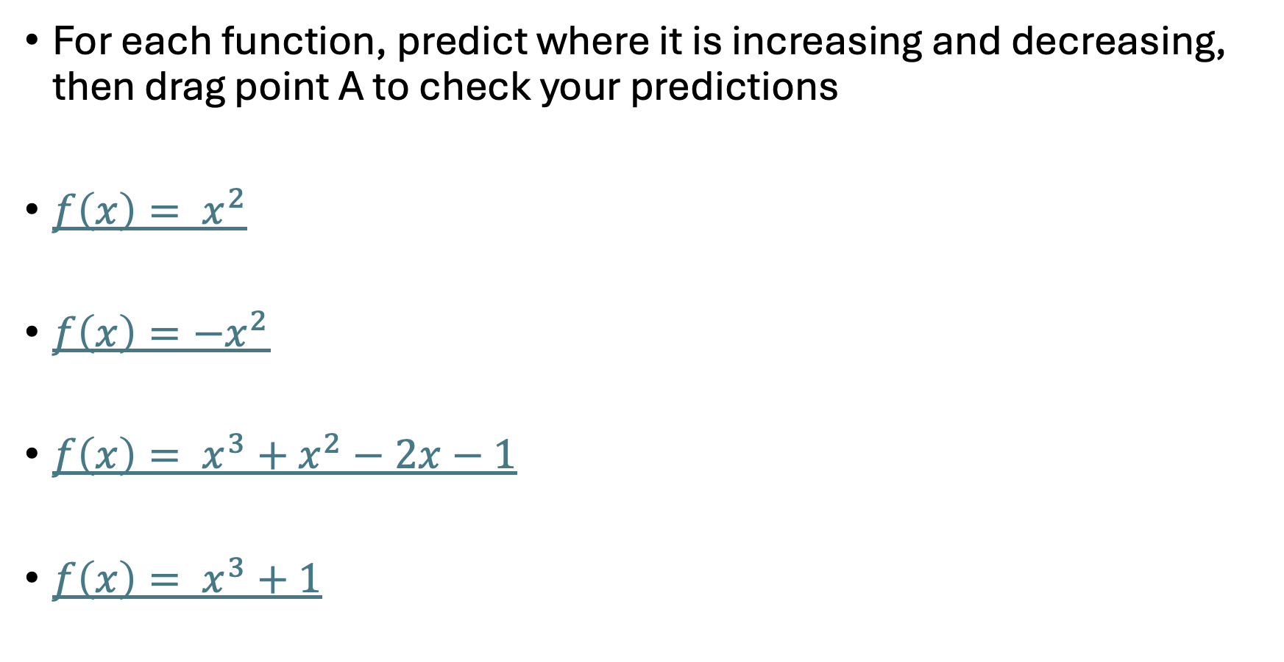
Using GeoGebra to determine where a function is increasing and decreasing
For each function, predict where it is increasing and decreasing, then drag point A to check your predictions
$f\left(x\right)= x^{2}$
$f\left(x\right)=−x^{2}$
$f\left(x\right)= x^{3}+x^{2}−2x−1$
$f\left(x\right)= x^{3}+1$

Slide 7
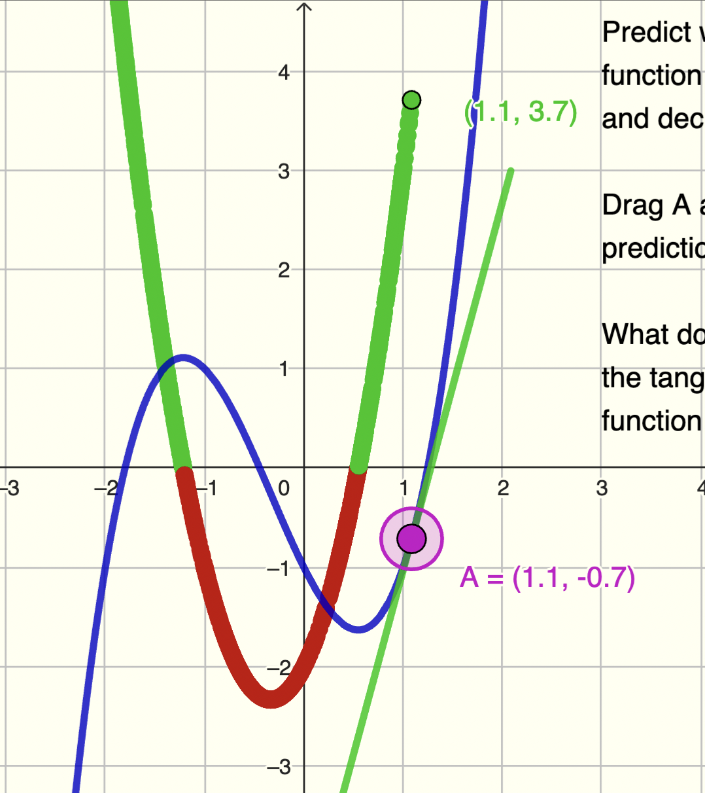
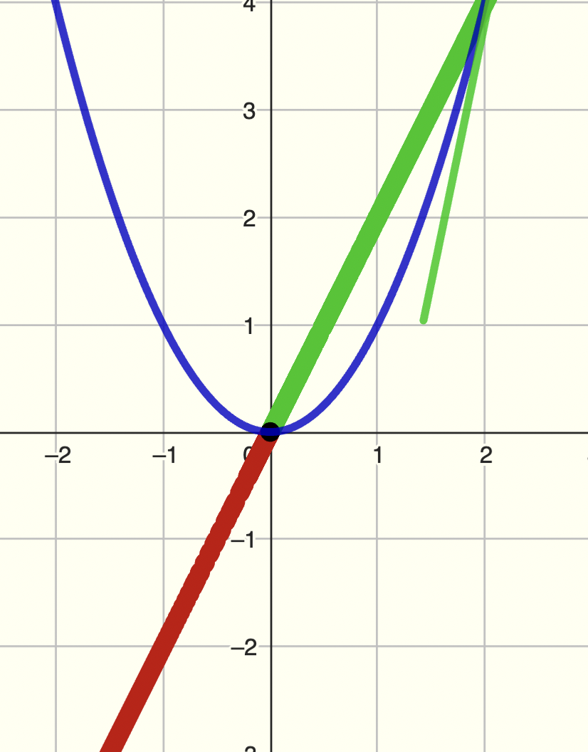
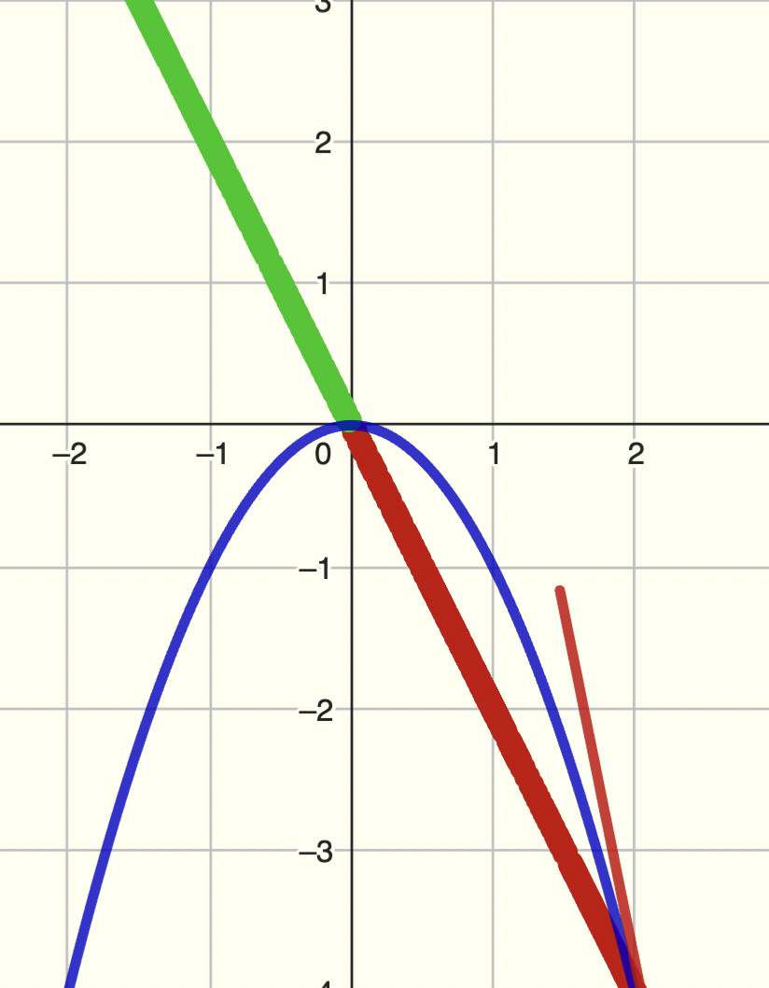
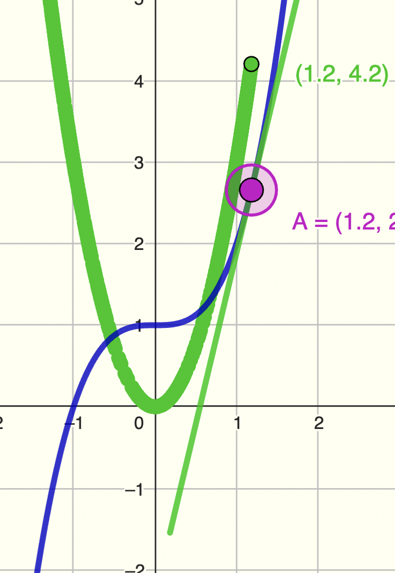
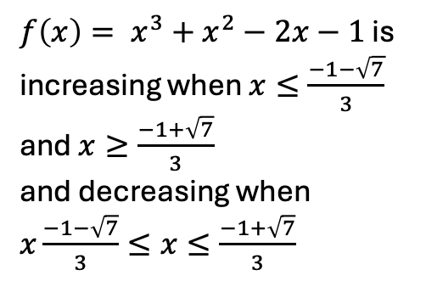
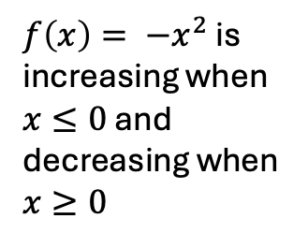
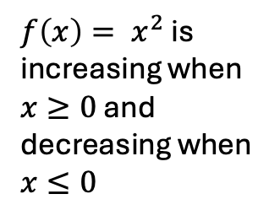
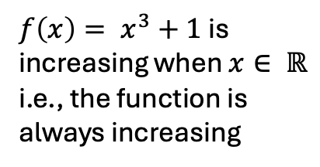
Where are the functions increasing and decreasing?
$f\left(x\right)= x^{2}$ is increasing when $x≥0$ and decreasing when $x≤0$
$f\left(x\right)= {−x}^{2}$ is increasing when $x≤0$ and decreasing when $x≥0$
$f\left(x\right)= x^{3}+x^{2}−2x−1$ is increasing when $x≤\frac{−1−\sqrt{7}}{3}$ and $x≥\frac{−1+\sqrt{7}}{3}$
and decreasing when $x\frac{−1−\sqrt{7}}{3}≤x≤\frac{−1+\sqrt{7}}{3}$
$f\left(x\right)= x^{3}+1$ is increasing when $x∈ ℝ$
i.e., the function is always increasing

Slide 8
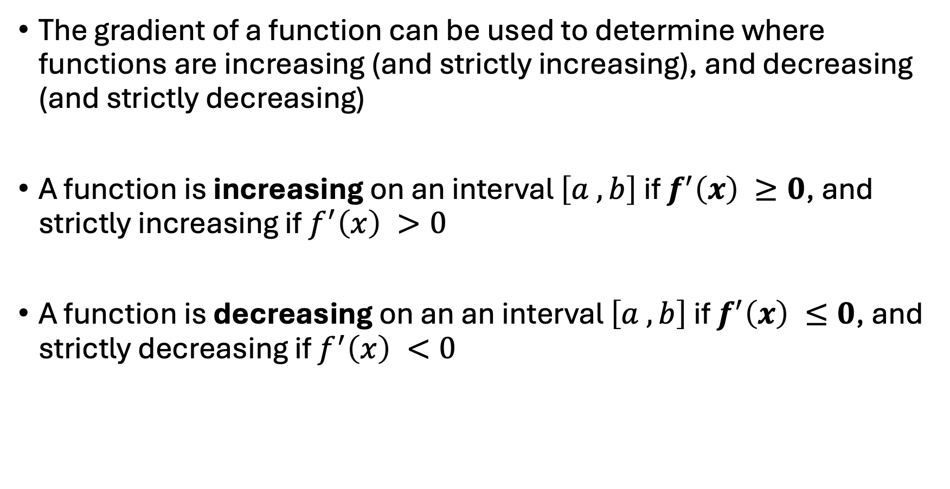
Summary
The gradient of a function can be used to determine where functions are increasing (and strictly increasing), and decreasing (and strictly decreasing)
A function is increasing on an interval $\left[a ,b\right]$ if $f^{′}\left(x\right) ≥0$, and strictly increasing if $f^{′}\left(x\right) >0$
A function is decreasing on an an interval $\left[a ,b\right]$ if $f^{′}\left(x\right) ≤0$, and strictly decreasing if $f^{′}\left(x\right) <0$

Slide 9
Suggestions for ‘what next’
Determining where functions are increasing and decreasing algebraically using differentiation
Fluency practice
Classifying stationary points (GeoGebra)

