Slide 1

Exploring the effect of the
$y$-intercept on the gradient function

Slide 2
Requisite prior knowledge for this activity
Finding the gradient of a straight line – GCSE / Year 12 Coordinate Geometry
Exploring the gradient of a curve using GeoGebra

Slide 3
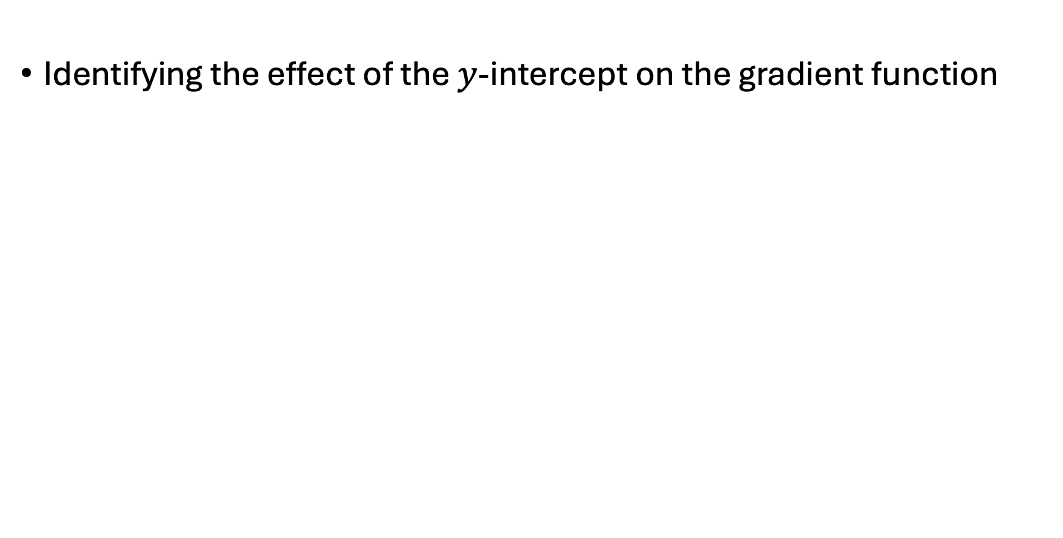
Learning Objective
Identifying the effect of the $y$-intercept on the gradient function

Slide 4
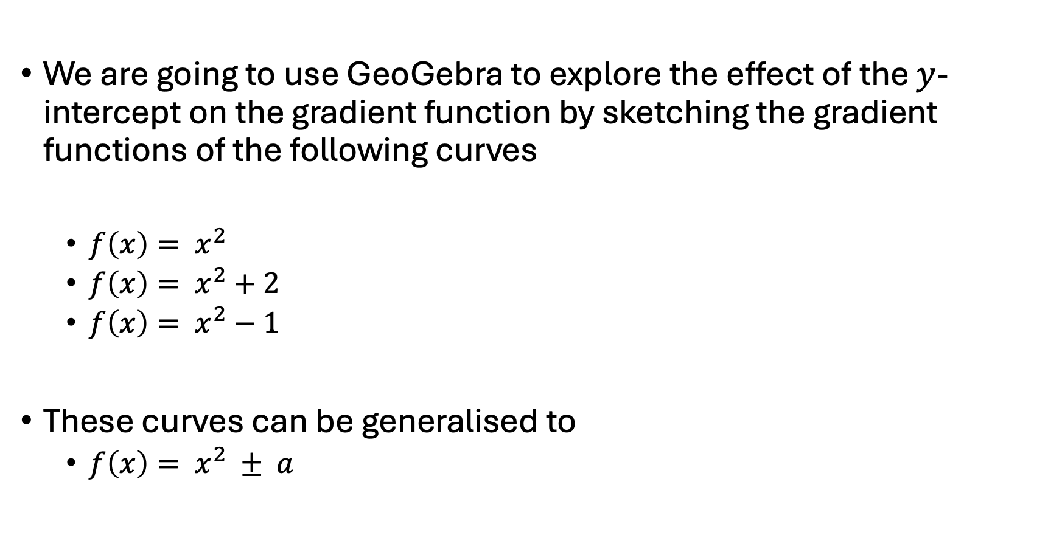

Using GeoGebra to identify the effect of the
$y$-intercept on the gradient function
We are going to use GeoGebra to explore the effect of the $y$-intercept on the gradient function by sketching the gradient functions of the following curves
  $f\left(x\right)= x^{2}$
  $f\left(x\right)= x^{2}+2$
  $f\left(x\right)= x^{2}−1$
These curves can be generalised to
  $f\left(x\right)= x^{2} ± a$

Slide 5
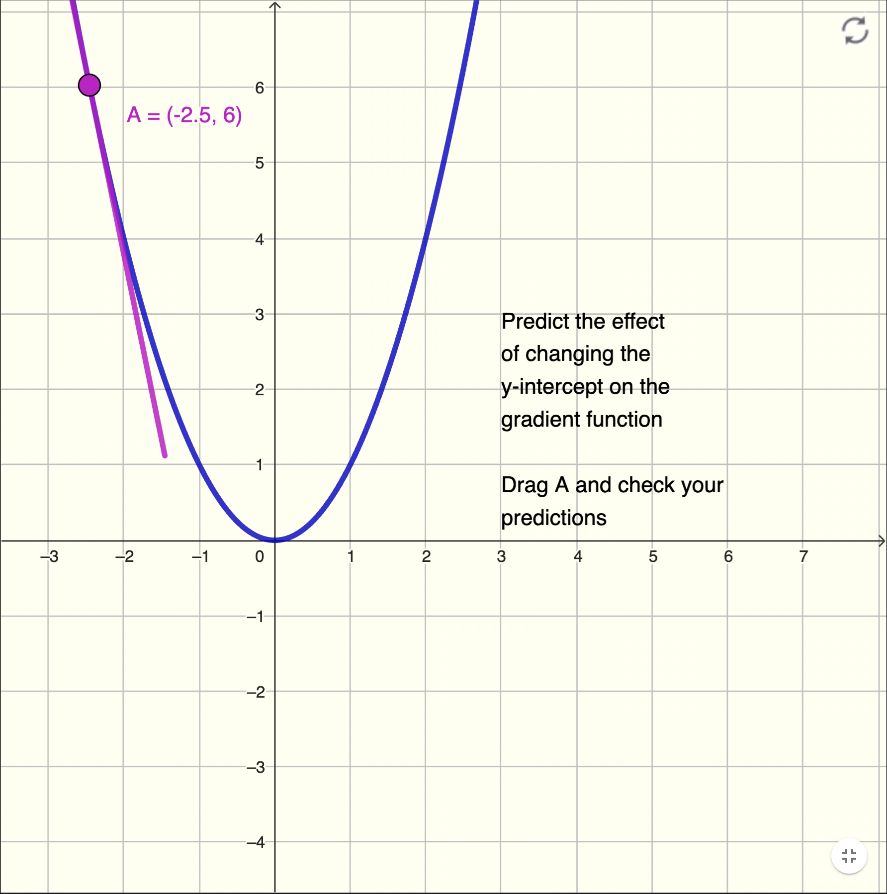
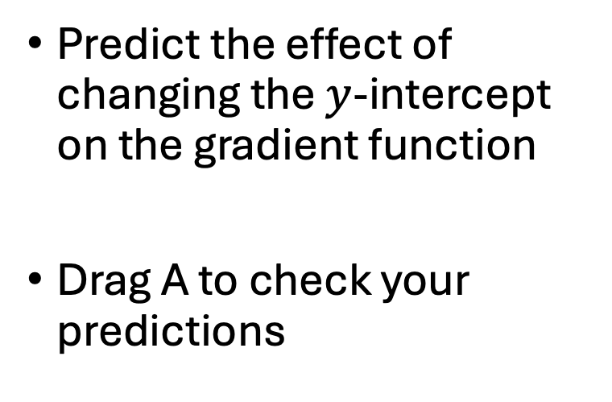
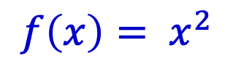
Using GeoGebra
$$f\left(x\right)= x^{2}$$
Reset
Predict the effect of changing the $y$-intercept on the gradient function
Drag A to check your predictions
Drag
point A
Tangent
at point A

Slide 6
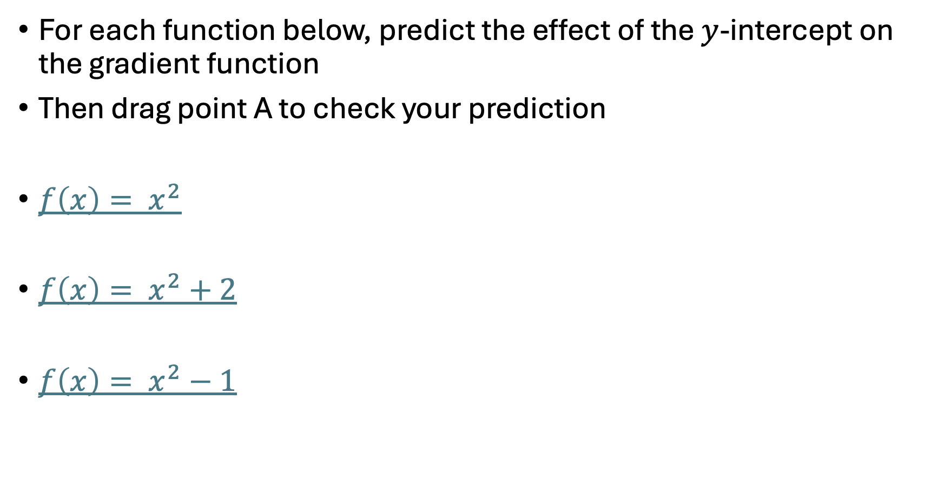
Using GeoGebra to identify the effect of the
$y$-intercept on the gradient function
For each function below, predict the effect of the $y$-intercept on the gradient function
Then drag point A to check your prediction
$f\left(x\right)= x^{2}$
$f\left(x\right)= x^{2}+2$
$f\left(x\right)= x^{2}−1$

Slide 7
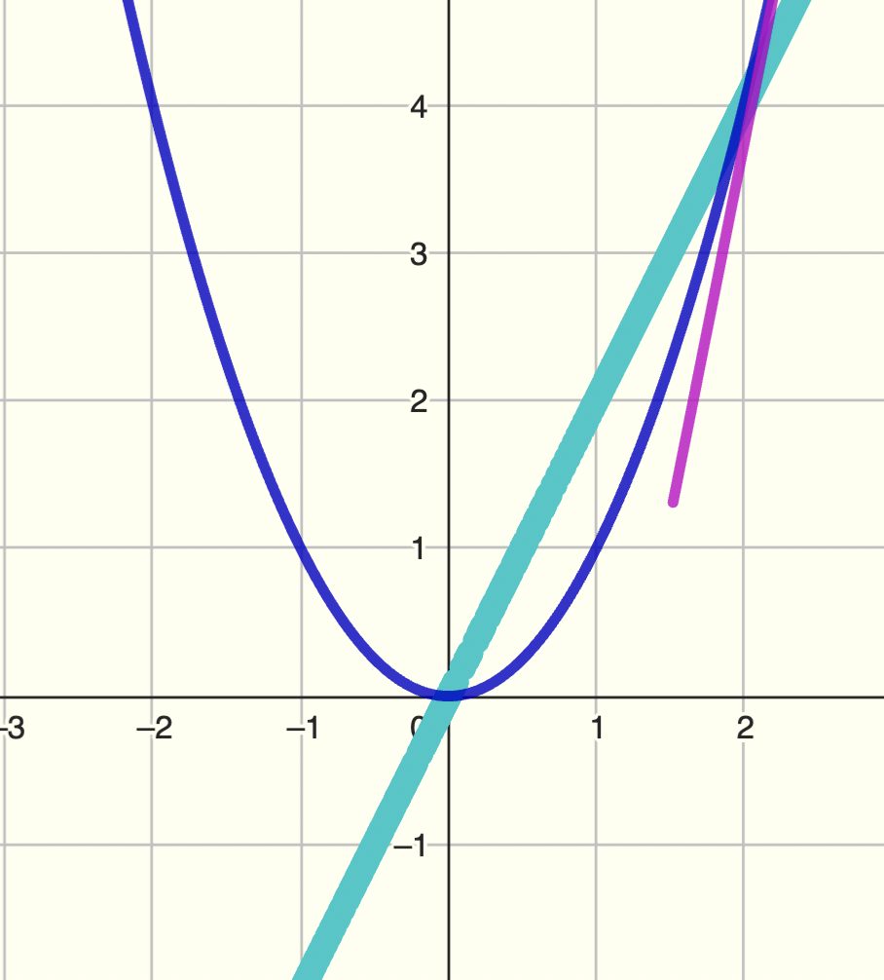
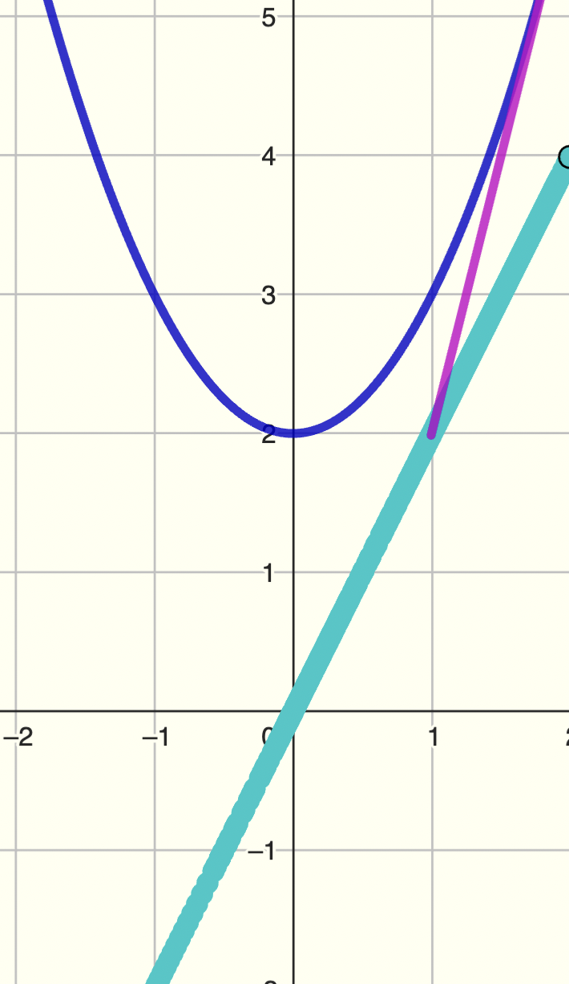
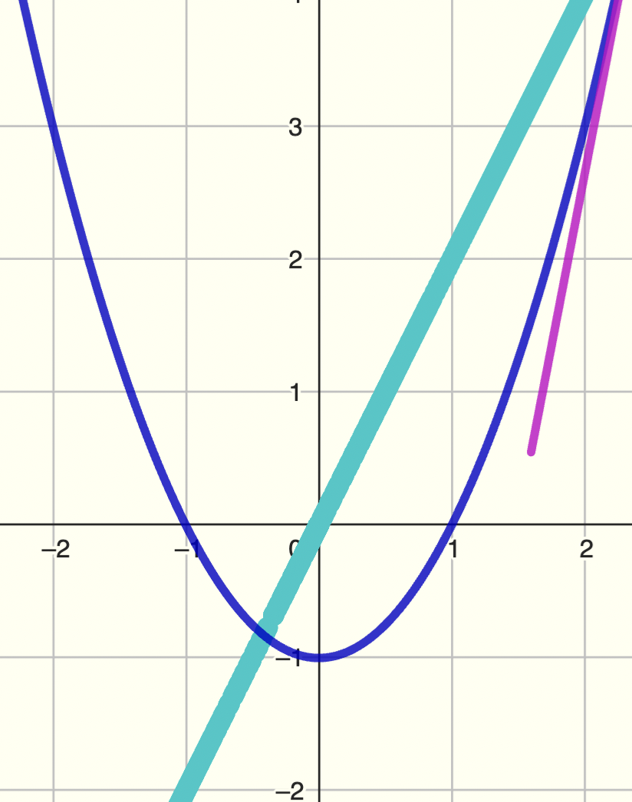

What is the effect of the $y$-intercept on the gradient function?

Slide 8
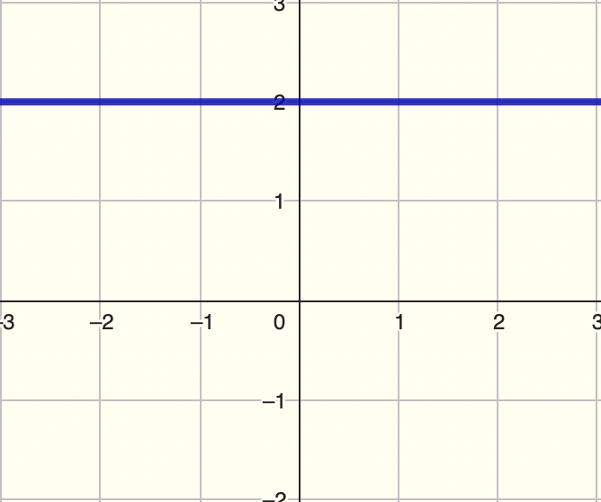
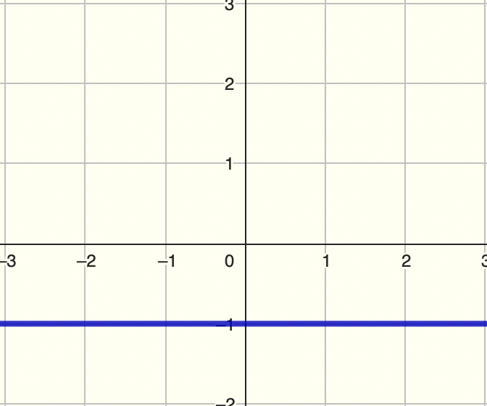
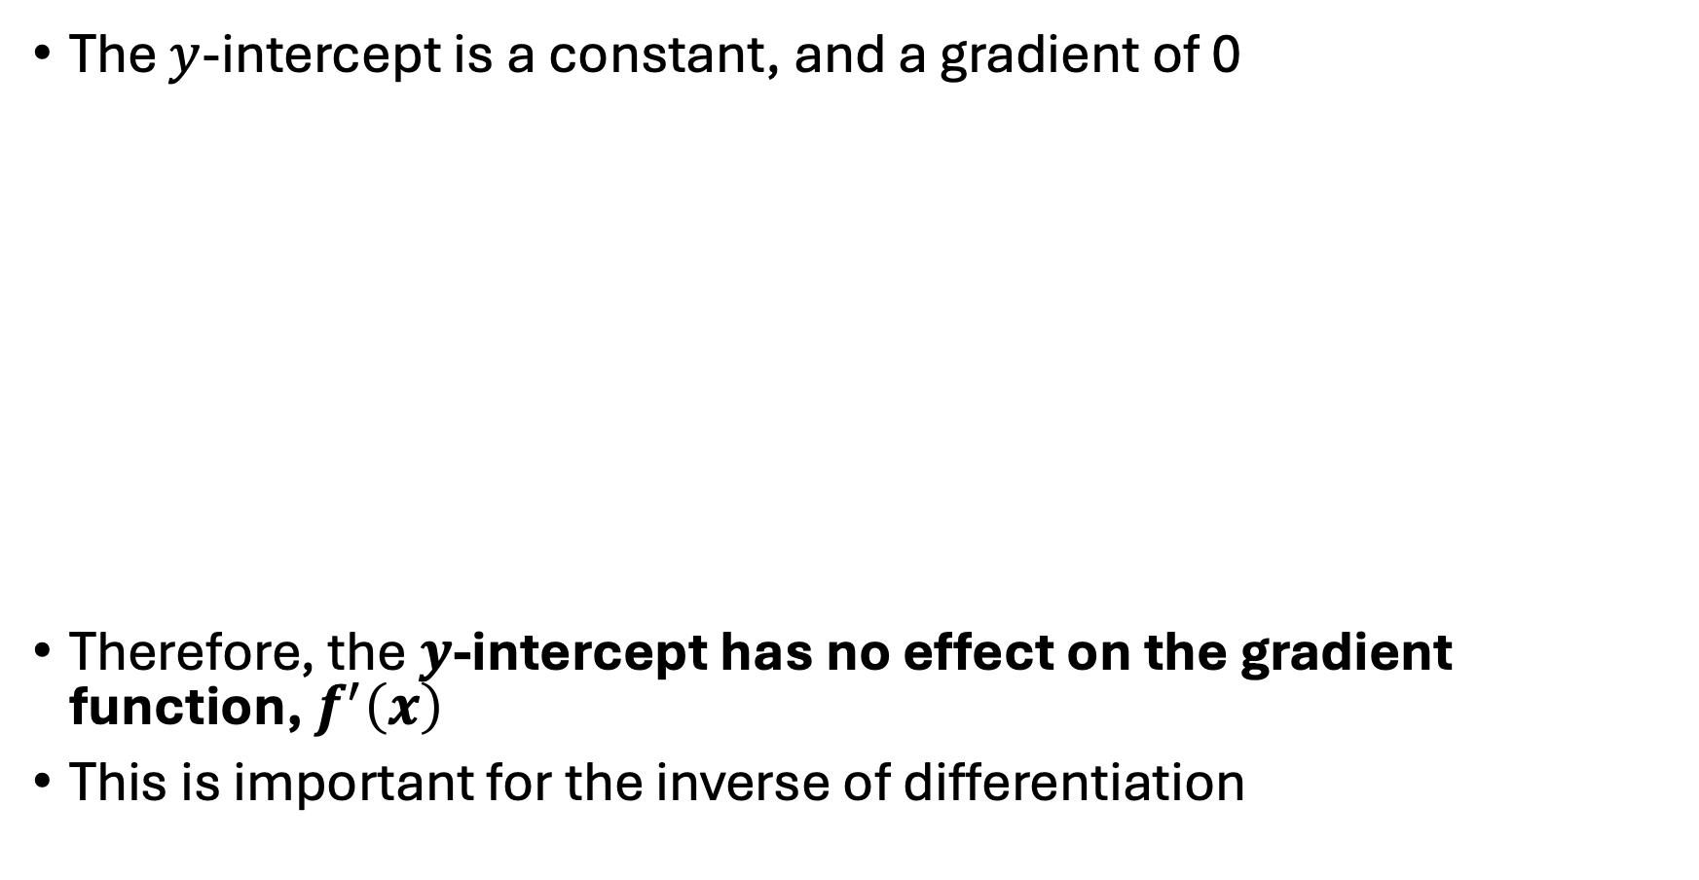
Summary
The $y$-intercept is a constant, and a gradient of 0
Therefore, the $y$-intercept has no effect on the gradient function, $f^{′}\left(x\right)$
This is important for the inverse of differentiation

Slide 9
Suggestions for ‘what next’
Classifying stationary points (GeoGebra)
Finding stationary points using differentiation
Fluency practice

