Slide 1
Sketching the gradient function of a curve

Slide 2
Requisite prior knowledge for this activity
Finding the gradient of a straight line – GCSE / Year 12 Coordinate Geometry
Exploring the gradient of a curve using GeoGebra

Slide 3
Learning Objective
Sketching the gradient function of a curve
Identify what the gradient of the tangent being zero corresponds to on the original function

Slide 4
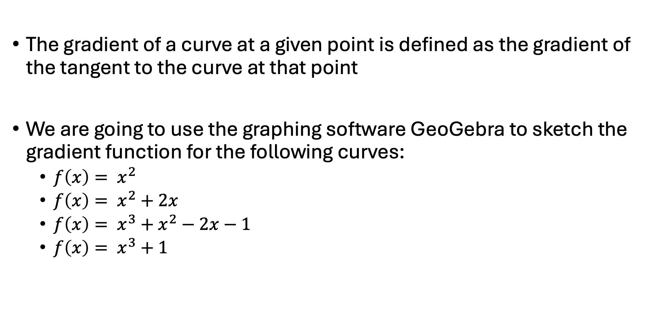
Using GeoGebra to sketch the gradient function of a curve
The gradient of a curve at a given point is defined as the gradient of the tangent to the curve at that point
We are going to use the graphing software GeoGebra to sketch the gradient function for the following curves:
  $f\left(x\right)= x^{2}$
  $f\left(x\right)= x^{2}+2x$
  $f\left(x\right)= x^{3}+x^{2}−2x−1$
  $f\left(x\right)= x^{3}+1$

Slide 5
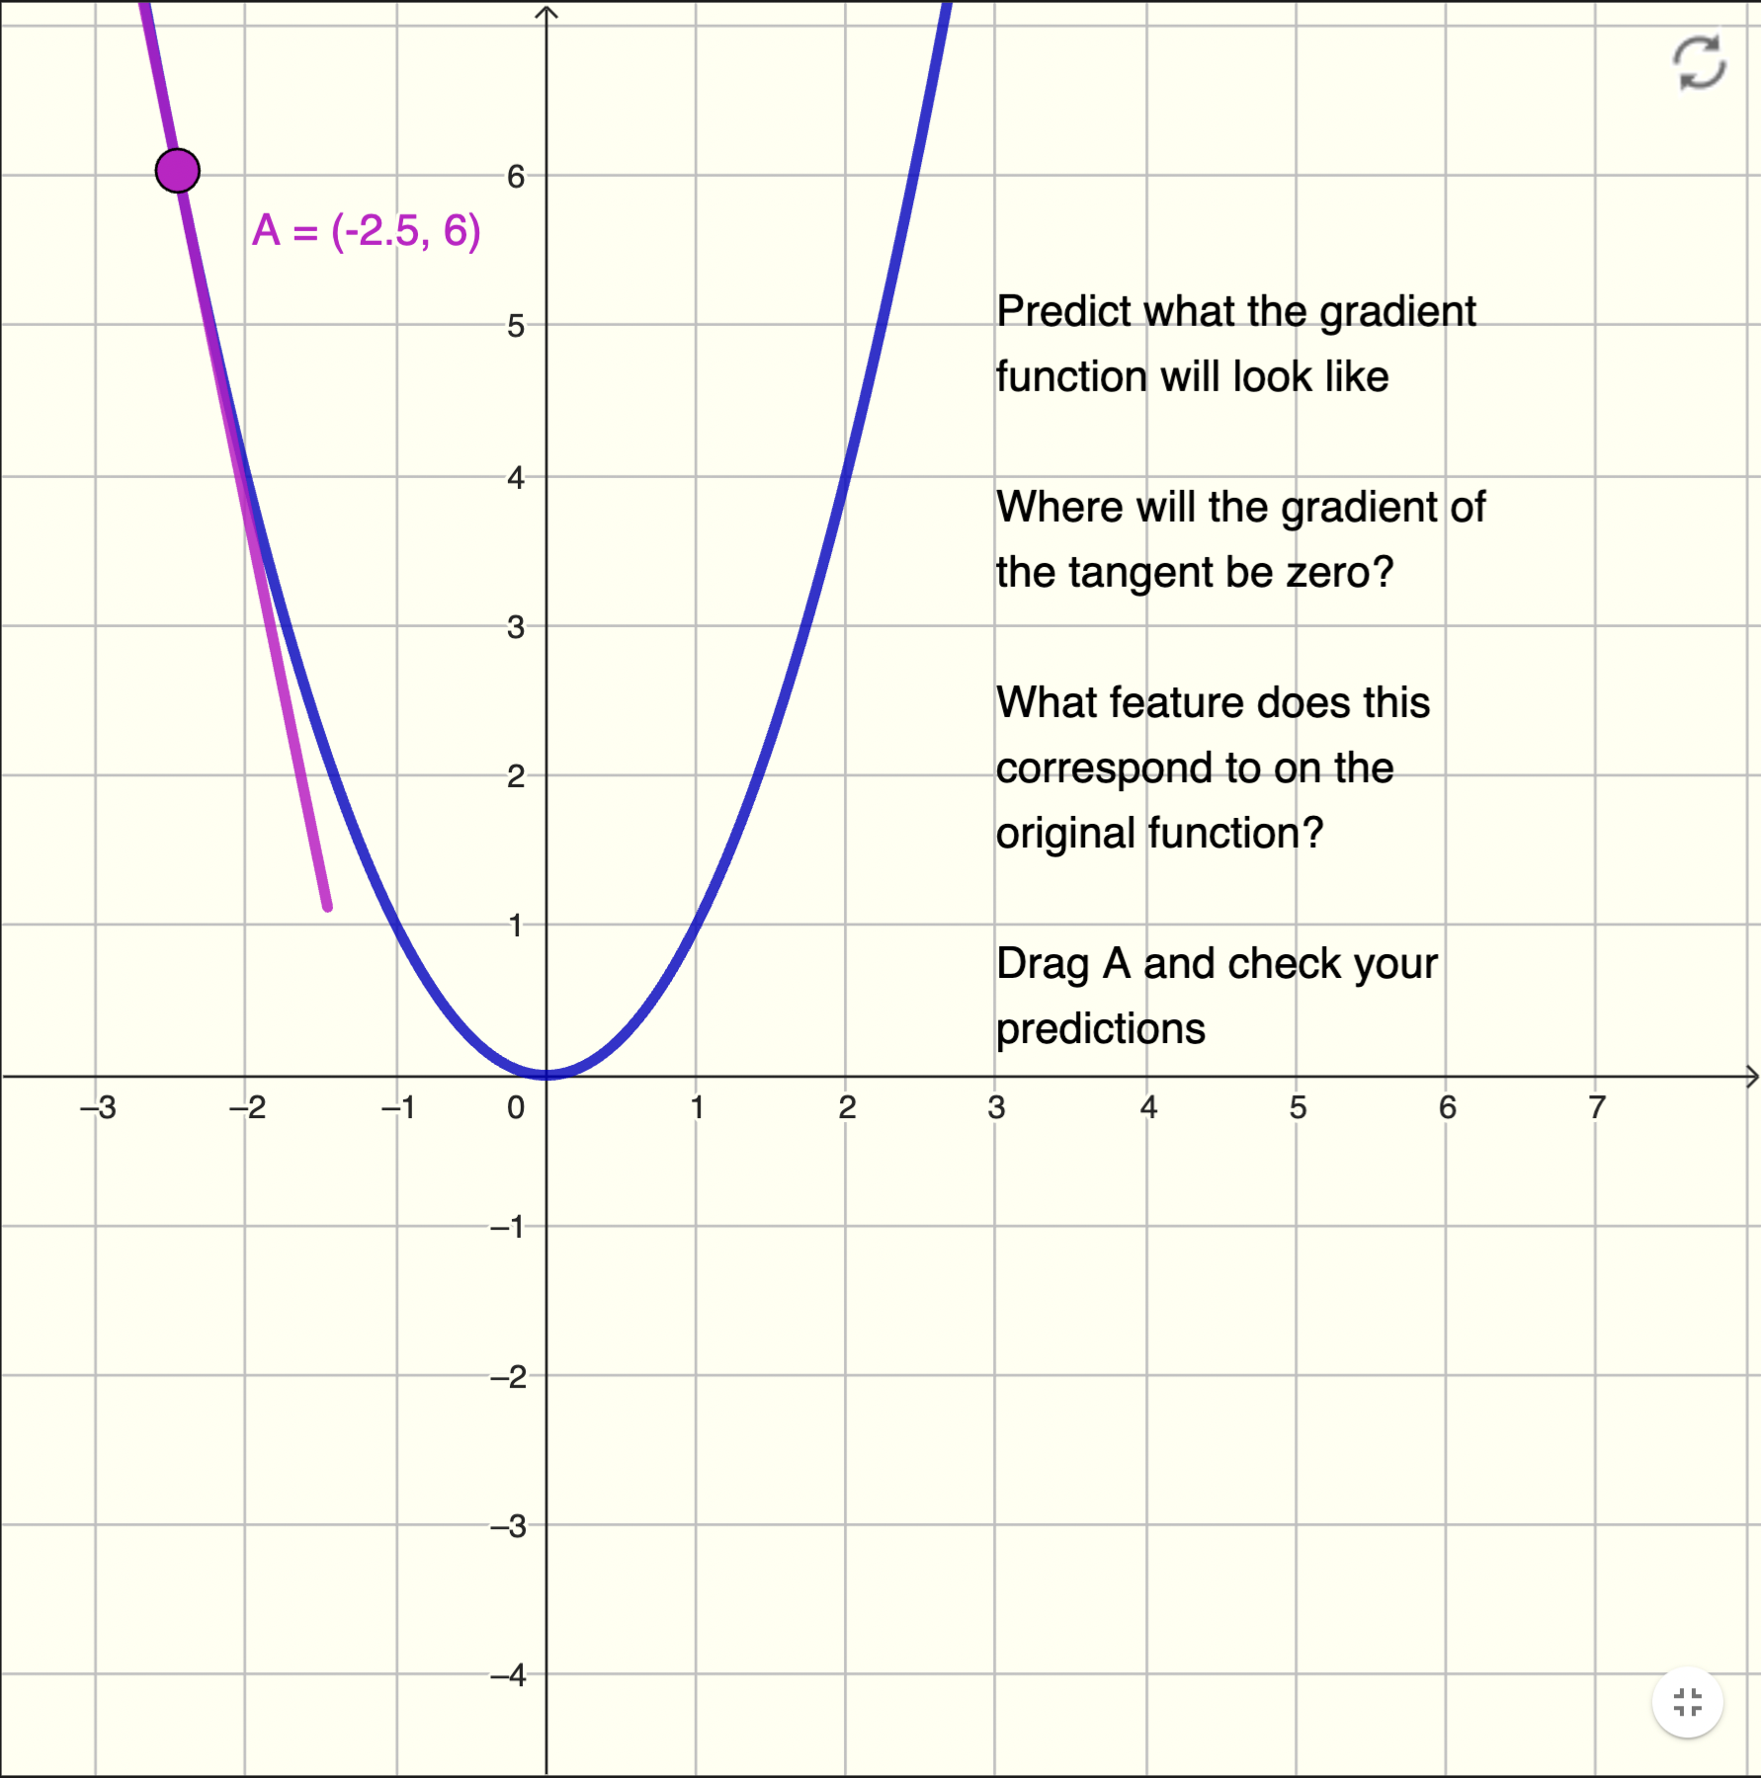
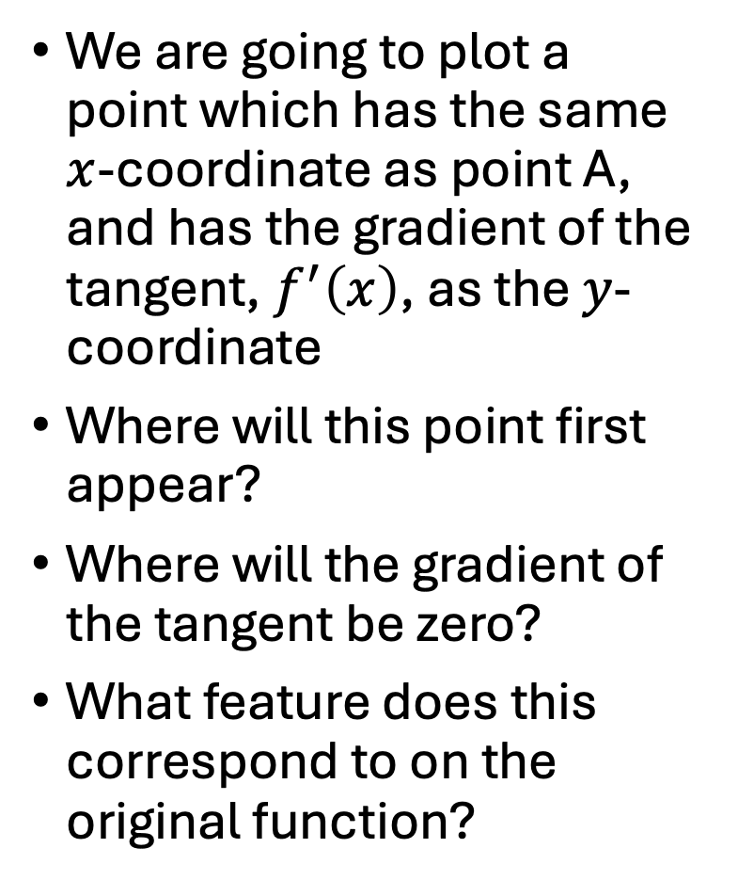
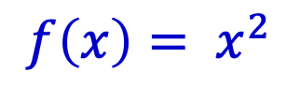
Using GeoGebra
$$f\left(x\right)= x^{2}$$
Reset
We are going to plot a point which has the same $x$-coordinate as point A, and has the gradient of the tangent,${ f}^{′}\left(x\right)$, as the $y$-coordinate
Where will this point first appear?
Where will the gradient of the tangent be zero?
What feature does this correspond to on the original function?
Drag
point A
Tangent
at point A

Slide 6
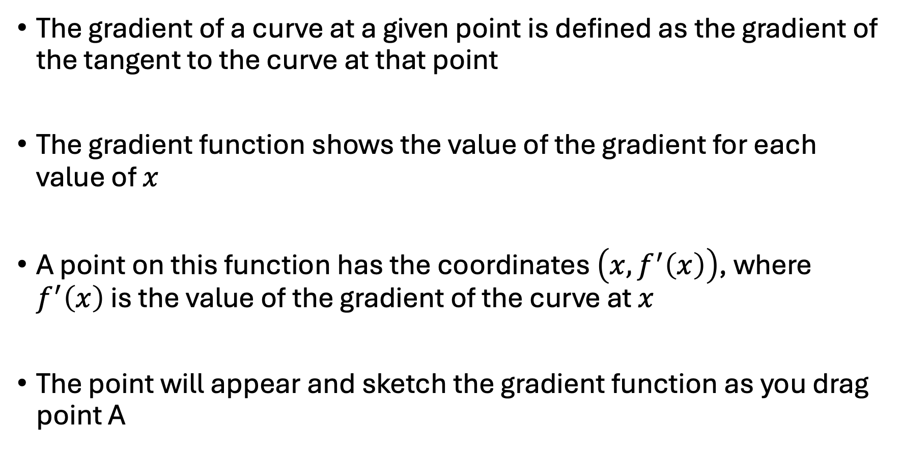
Using GeoGebra to sketch the gradient function of a curve
The gradient of a curve at a given point is defined as the gradient of the tangent to the curve at that point
The gradient function shows the value of the gradient for each value of $x$
A point on this function has the coordinates $\left(x, f^{′}\left(x\right)\right)$, where $f^{′}\left(x\right)$ is the value of the gradient of the curve at $x$
The point will appear and sketch the gradient function as you drag point A

Slide 7
Using GeoGebra to sketch the gradient function of a curve
For each function, predict what the gradient function will look like by thinking about the following questions
  Where will the point first appear?
  Where will the gradient of the tangent be zero?
  What feature does this correspond to on the original function?
When you have answered these questions, drag point A to check your prediction

Slide 8
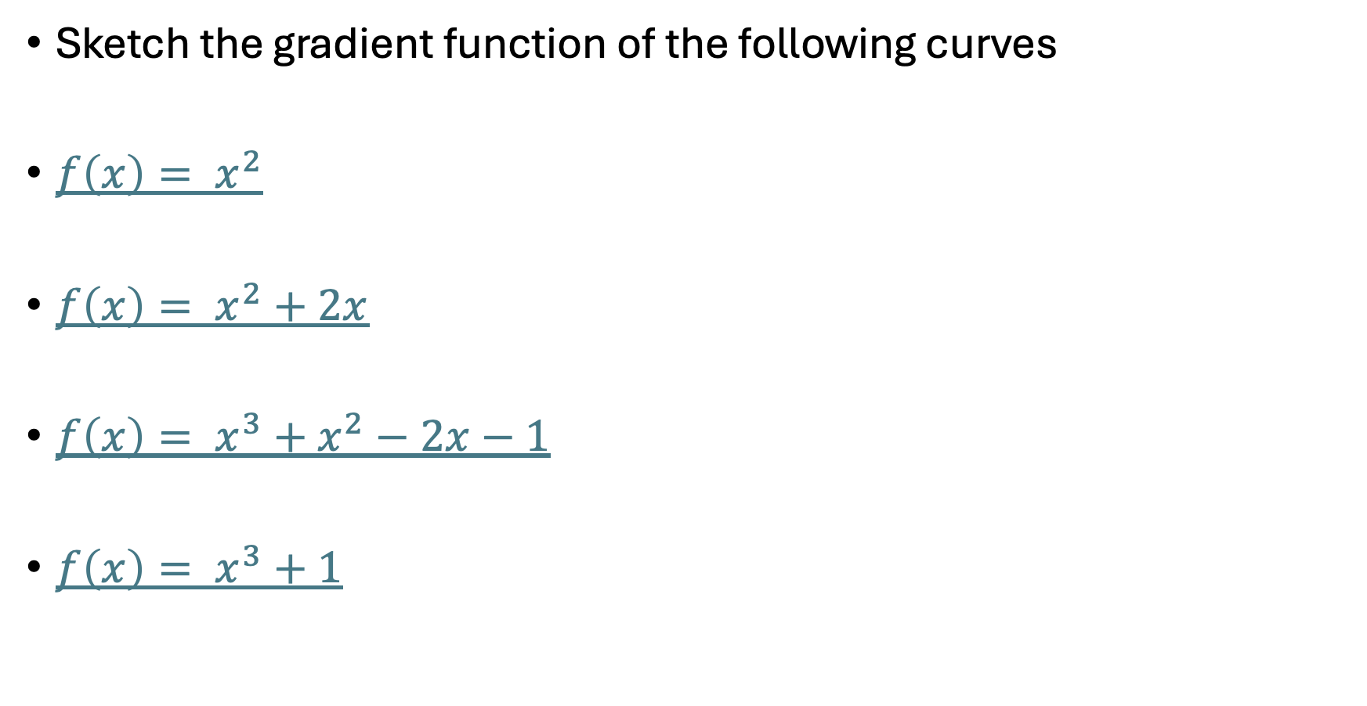
Using GeoGebra to sketch the gradient function of a curve
Sketch the gradient function of the following curves
$f\left(x\right)= x^{2}$
$f\left(x\right)= x^{2}+2x$
$f\left(x\right)= x^{3}+x^{2}−2x−1$
$f\left(x\right)= x^{3}+1$

Slide 9
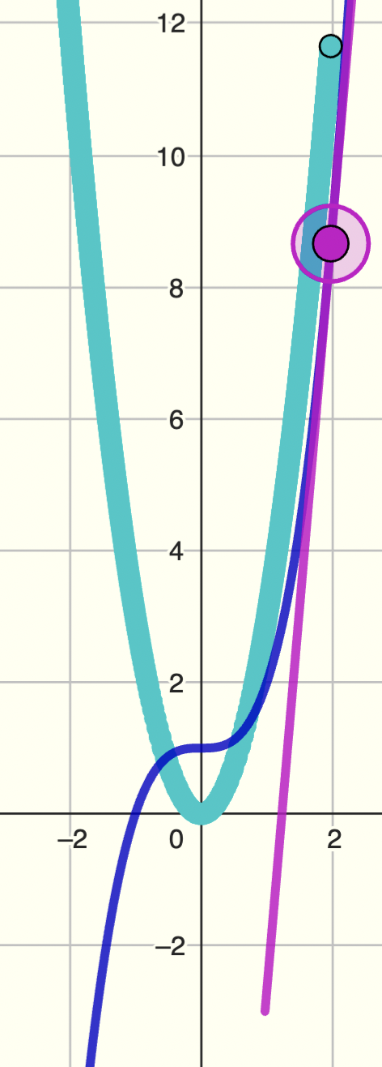
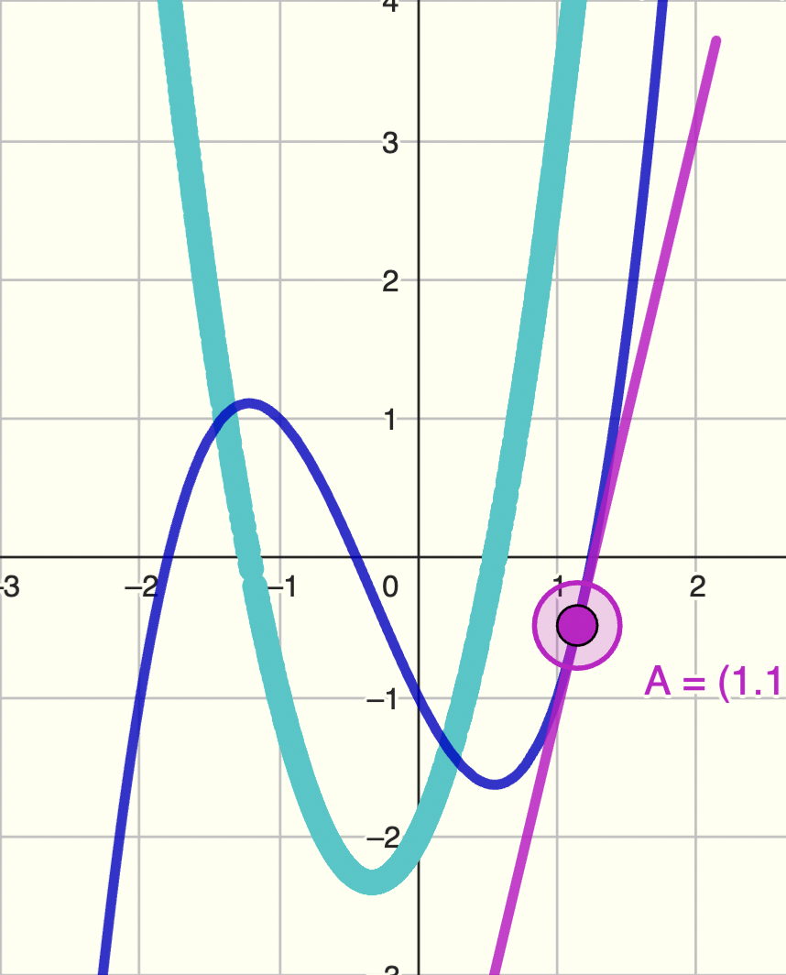
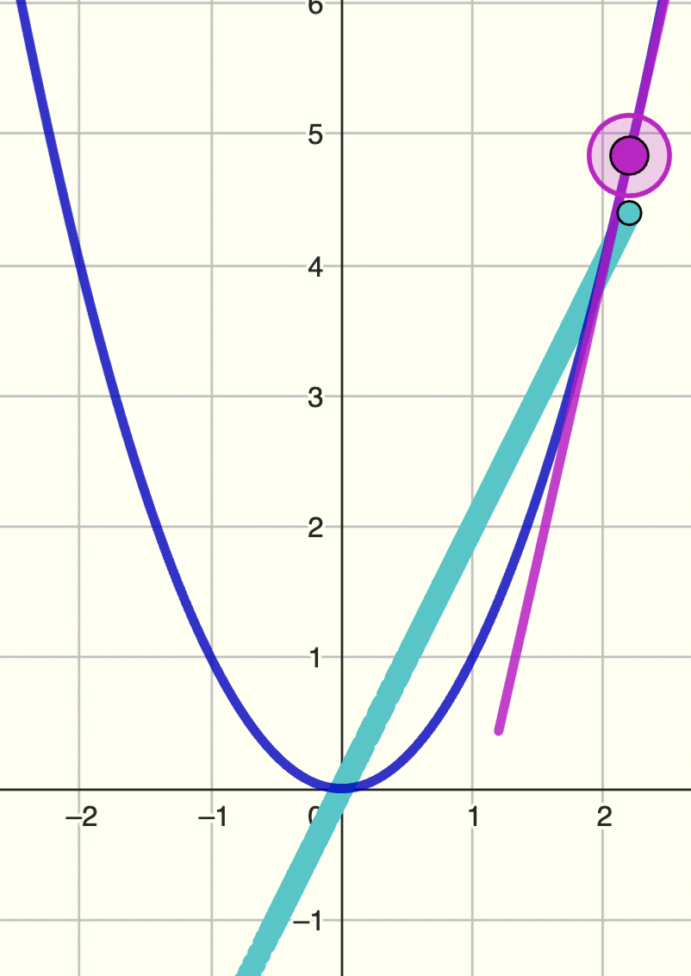
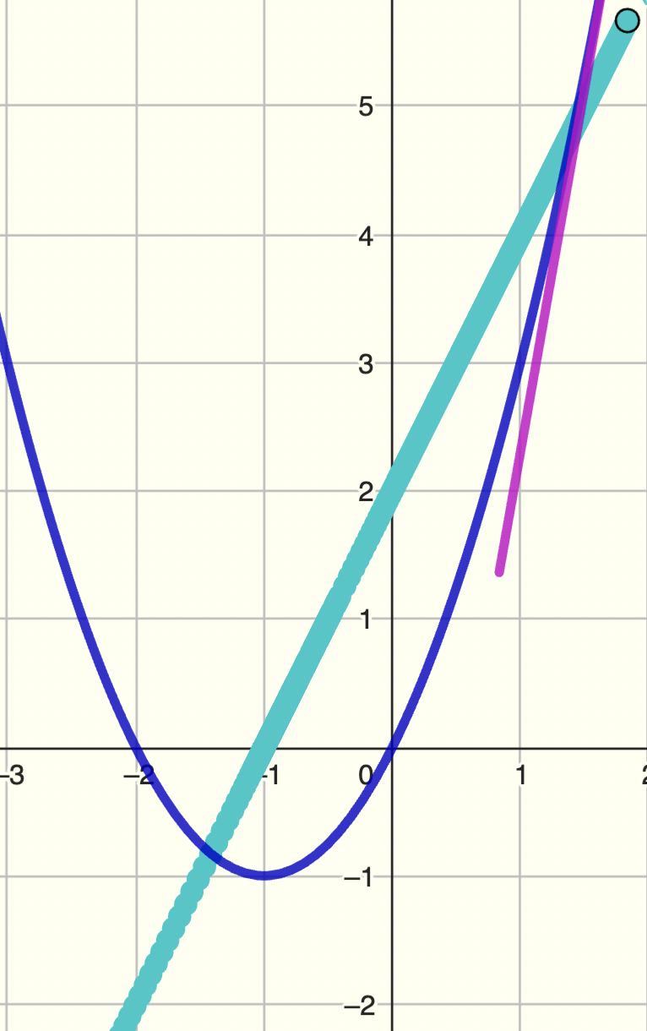
What feature on the original function does a gradient of zero correspond to?

Slide 10
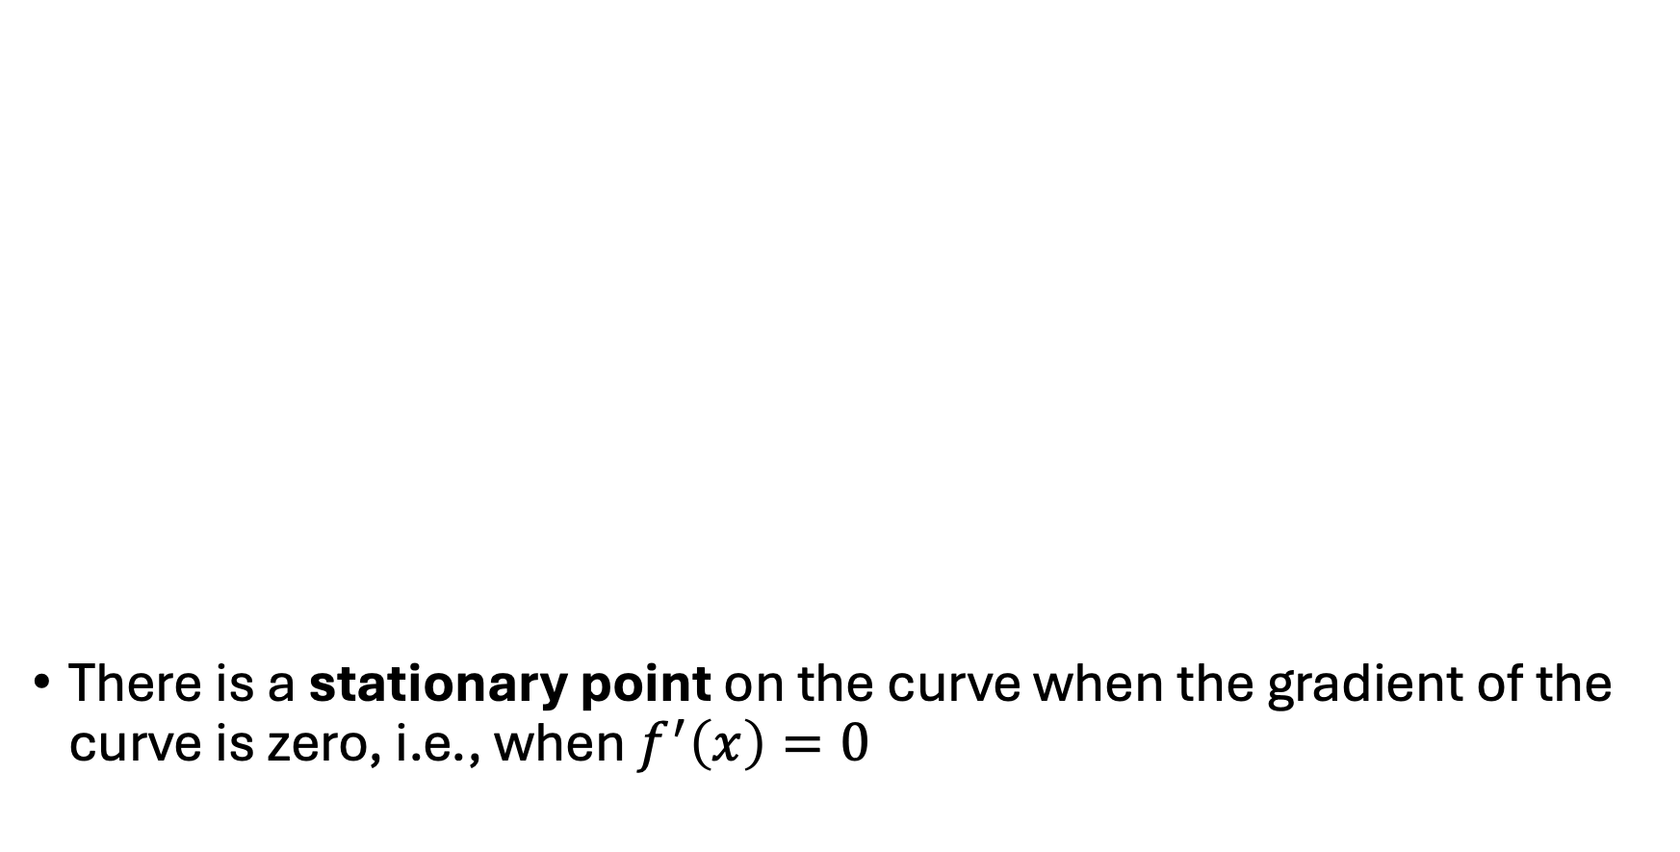
Summary
There is a stationary point on the curve when the gradient of the curve is zero, i.e., when $f^{′}\left(x\right)=0$

Slide 11
Suggestions for ‘what next’
Exploring the effect of the y-intercept on a gradient function (GeoGebra)
Finding stationary points using differentiation
Fluency practice
Classifying stationary points (GeoGebra)

