Slide 1
Derivative as gradient of the tangent to the graph at a point

Slide 2
Requisite prior knowledge for this activity
Finding the gradient of a straight line – GCSE / Year 12 Coordinate Geometry

Slide 3
Learning Objective
Explore finding the gradient of a curve from a graph
Generalise the findings

Slide 4
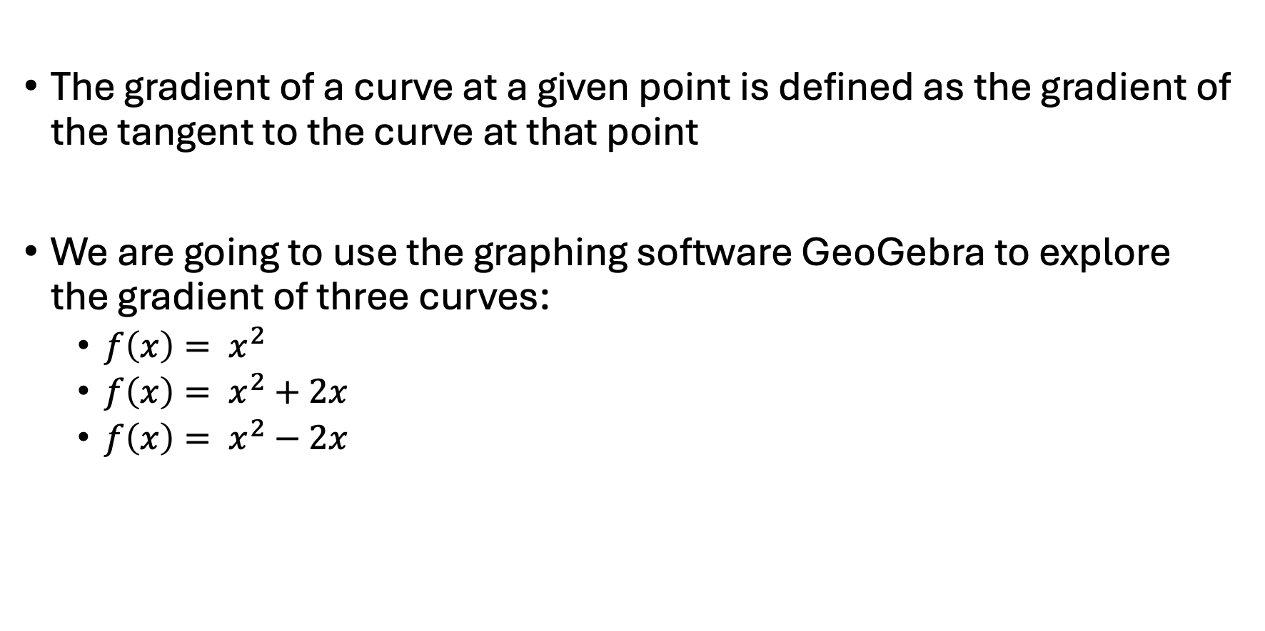
Using GeoGebra to find the gradient of a point on a curve
The gradient of a curve at a given point is defined as the gradient of the tangent to the curve at that point
We are going to use the graphing software GeoGebra to explore the gradient of three curves:
  $f\left(x\right)= x^{2}$
  $f\left(x\right)= x^{2}+2x$
  $f\left(x\right)= x^{2}−2x$

Slide 5
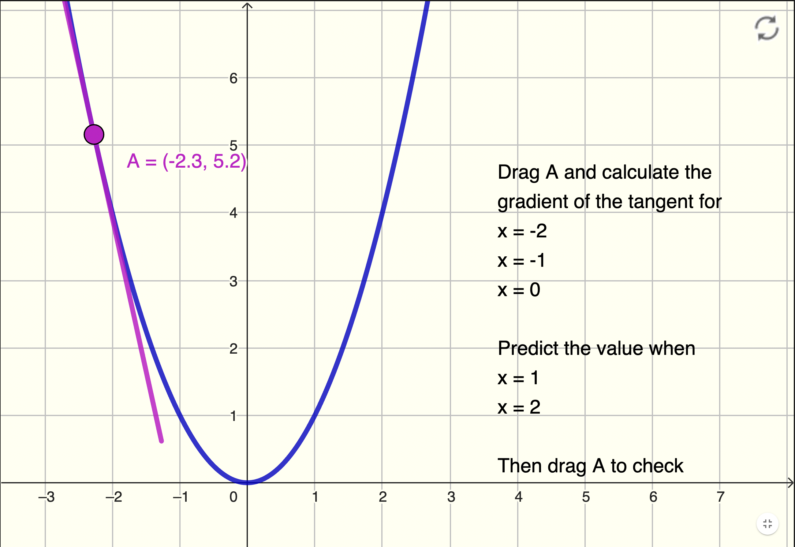
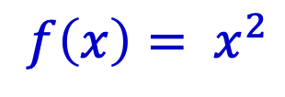
Using GeoGebra
$$f\left(x\right)= x^{2}$$
Drag point A
Reset
Tangent at point A

Slide 6
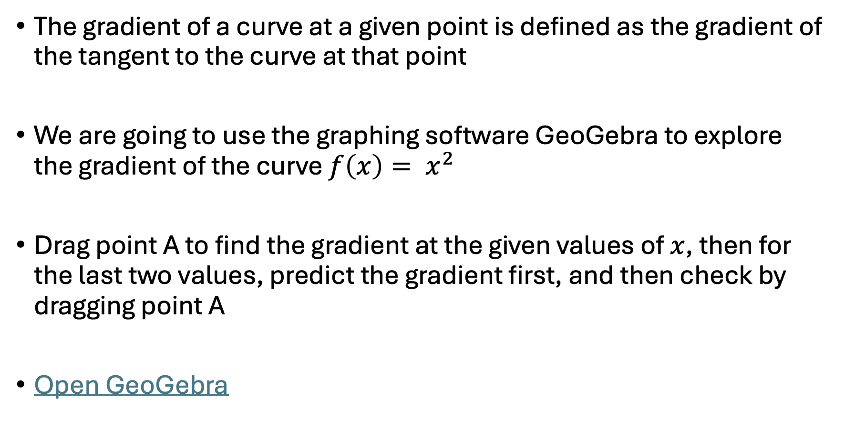
Using GeoGebra to find the gradient of a point on a curve
The gradient of a curve at a given point is defined as the gradient of the tangent to the curve at that point
We are going to use the graphing software GeoGebra to explore the gradient of the curve $f\left(x\right)= x^{2}$
Drag point A to find the gradient at the given values of $x$, then for the last two values, predict the gradient first, and then check by dragging point A
Open GeoGebra

Slide 7
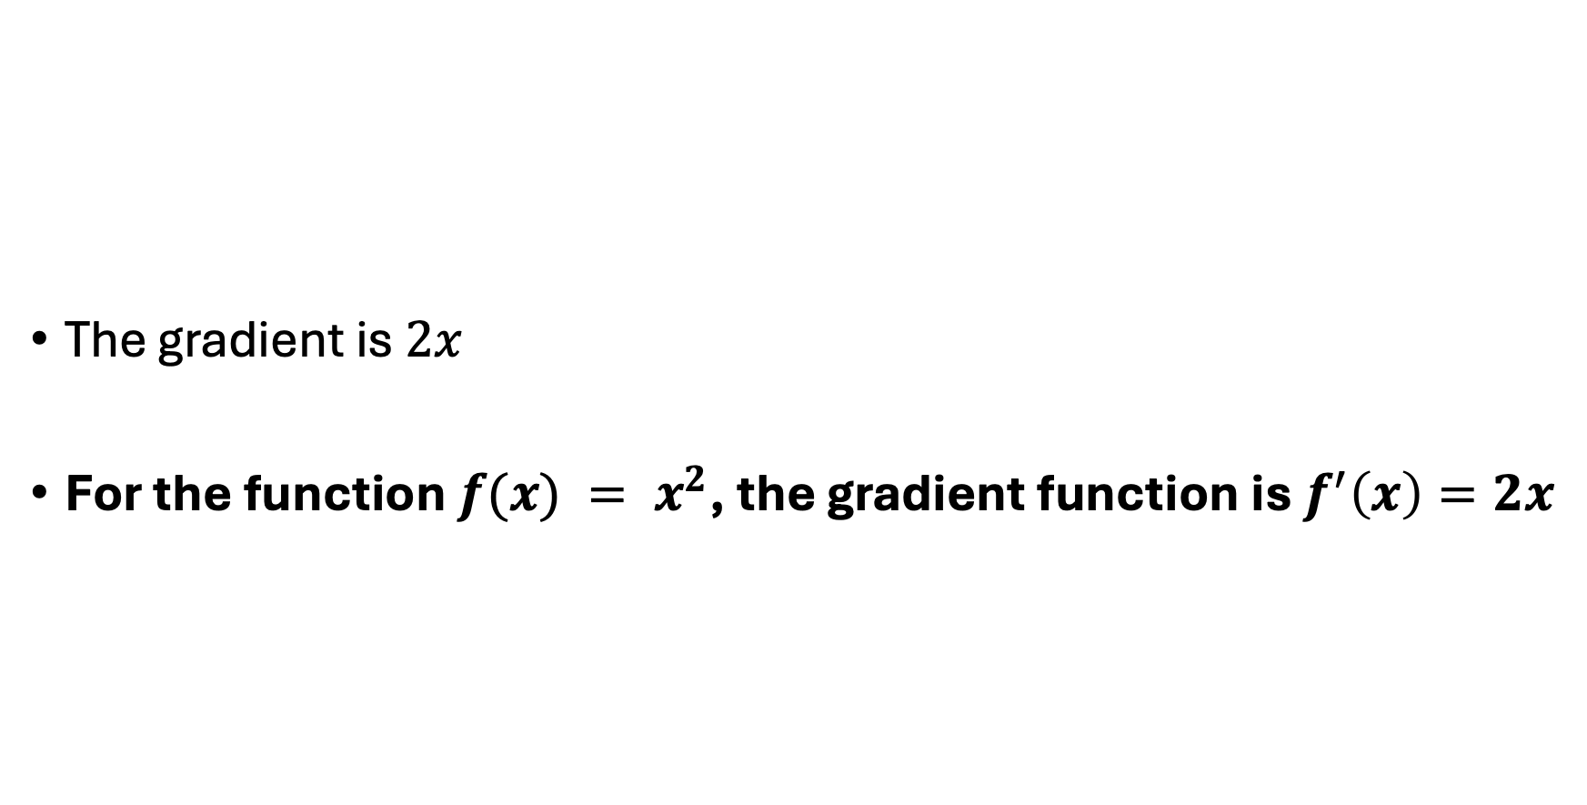
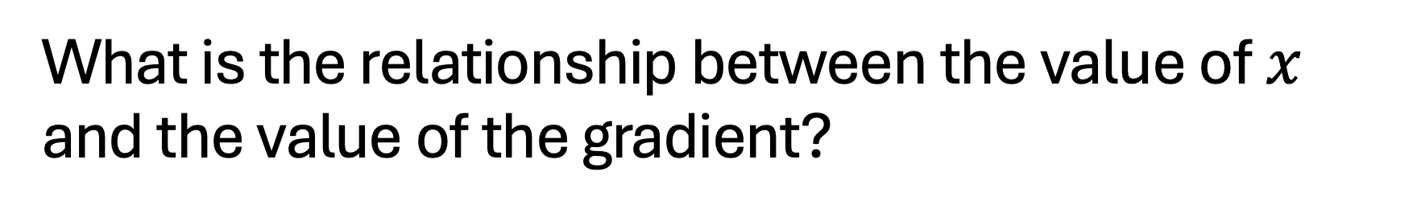
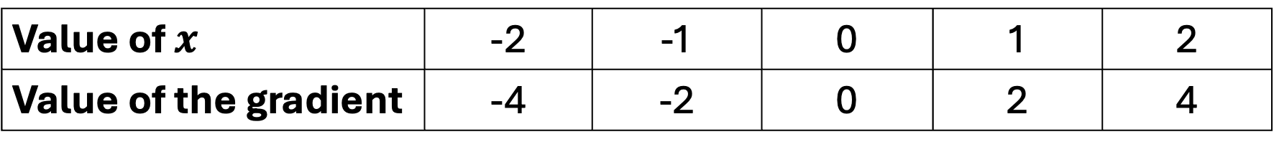
What is the relationship between the value of $x$ and the value of the gradient?
The gradient is $2x$
For the function $f(x) = x^{2}$, the gradient function is $f^{′}\left(x\right)=2x$
Value of $x$ | -2 | -1 | 0 | 1 | 2
Value of the gradient | -4 | -2 | 0 | 2 | 4

Slide 8

Using GeoGebra to find the gradient of a point on a curve
The gradient of a curve at a given point is defined at the gradient of the tangent to the curve at that point
We are going to use the graphing software GeoGebra to explore the gradient of the curve $f\left(x\right)= x^{2}+2x$
Drag point A to find the gradient at the given values of $x$, then for the last two values, predict the gradient first, and then check by dragging point A
Open GeoGebra

Slide 9
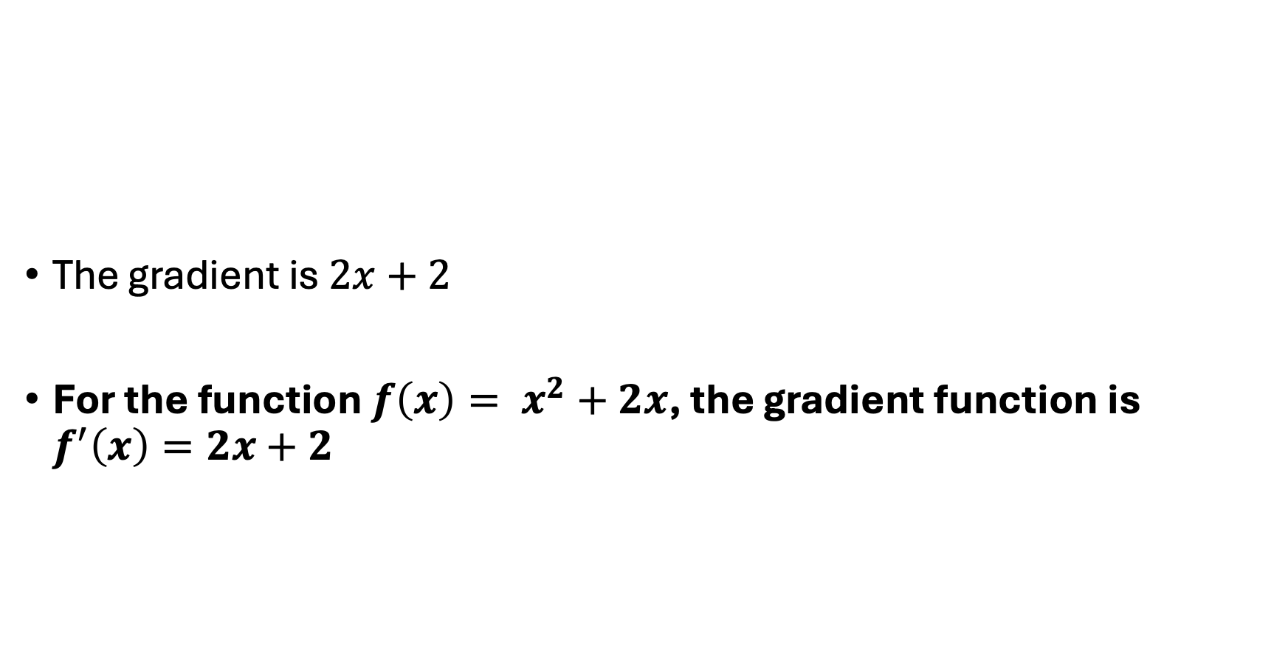
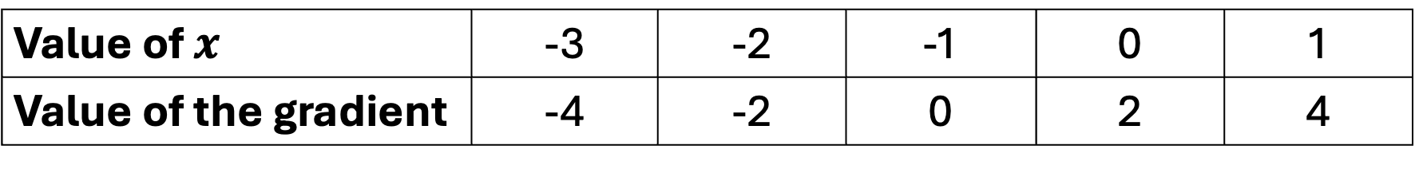
What is the relationship between the value of $x$ and the value of the gradient?
The gradient is $2x+2$
For the function $f\left(x\right)= x^{2}+2x$, the gradient function is $f^{′}\left(x\right)=2x+2$
Value of $x$ | -3 | -2 | -1 | 0 | 1
Value of the gradient | -4 | -2 | 0 | 2 | 4

Slide 10

Using GeoGebra to find the gradient of a point on a curve
The gradient of a curve at a given point is defined at the gradient of the tangent to the curve at that point
We are going to use the graphing software GeoGebra to explore the gradient of the curve $f\left(x\right)= x^{2}−2x$
Drag point A to find the gradient at the given values of $x$, then for the last two values, predict the gradient first, and then check by dragging point A
Open GeoGebra

Slide 11
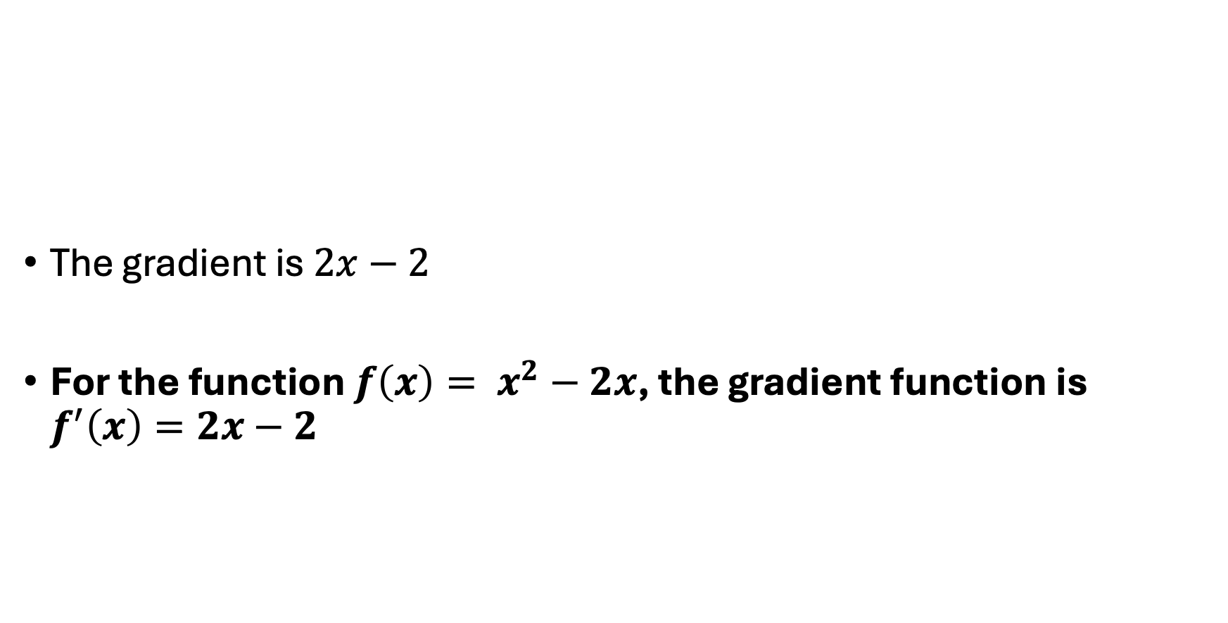
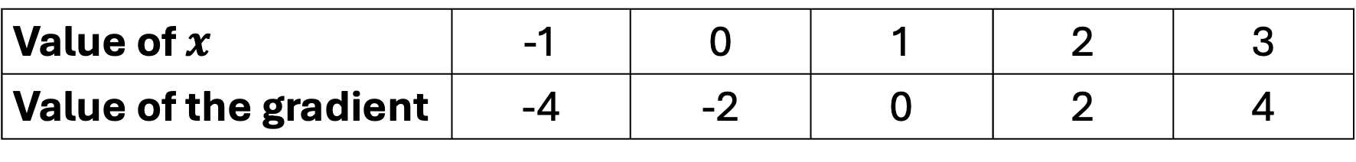
What is the relationship between the value of $x$ and the value of the gradient?
The gradient is $2x−2$
For the function $f\left(x\right)= x^{2}−2x$, the gradient function is $f^{′}\left(x\right)=2x−2$
Value of $x$ | -1 | 0 | 1 | 2 | 3
Value of the gradient | -4 | -2 | 0 | 2 | 4

Slide 12
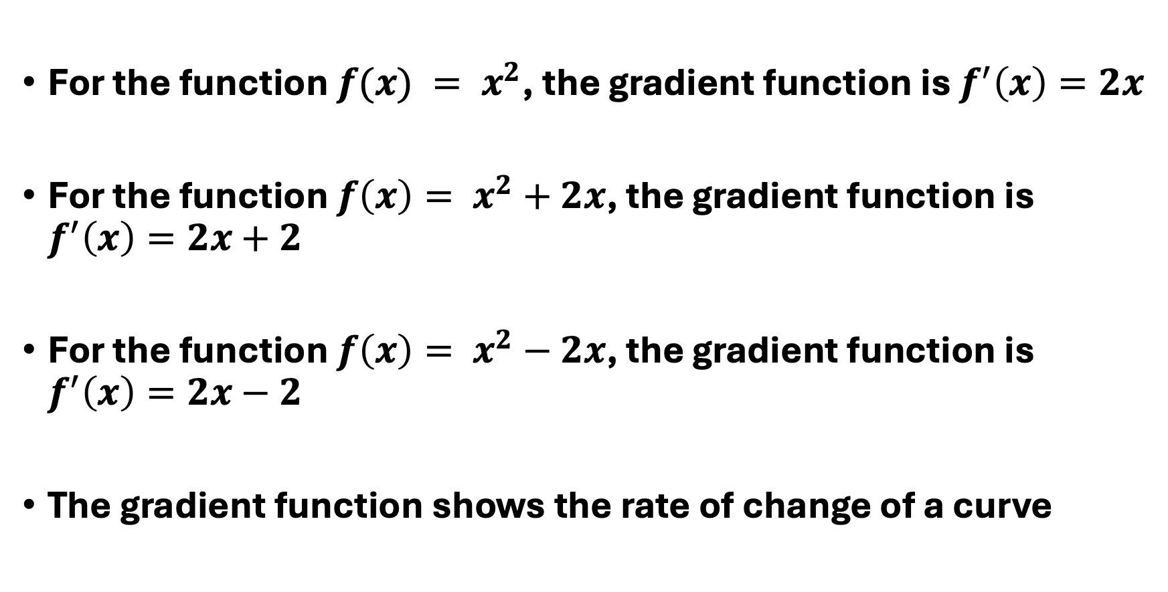
Summary
For the function $f(x) = x^{2}$, the gradient function is $f^{′}\left(x\right)=2x$
For the function $f\left(x\right)= x^{2}+2x$, the gradient function is $f^{′}\left(x\right)=2x+2$
For the function $f\left(x\right)= x^{2}−2x$, the gradient function is $f^{′}\left(x\right)=2x−2$
The gradient function shows the rate of change of a curve

Slide 13
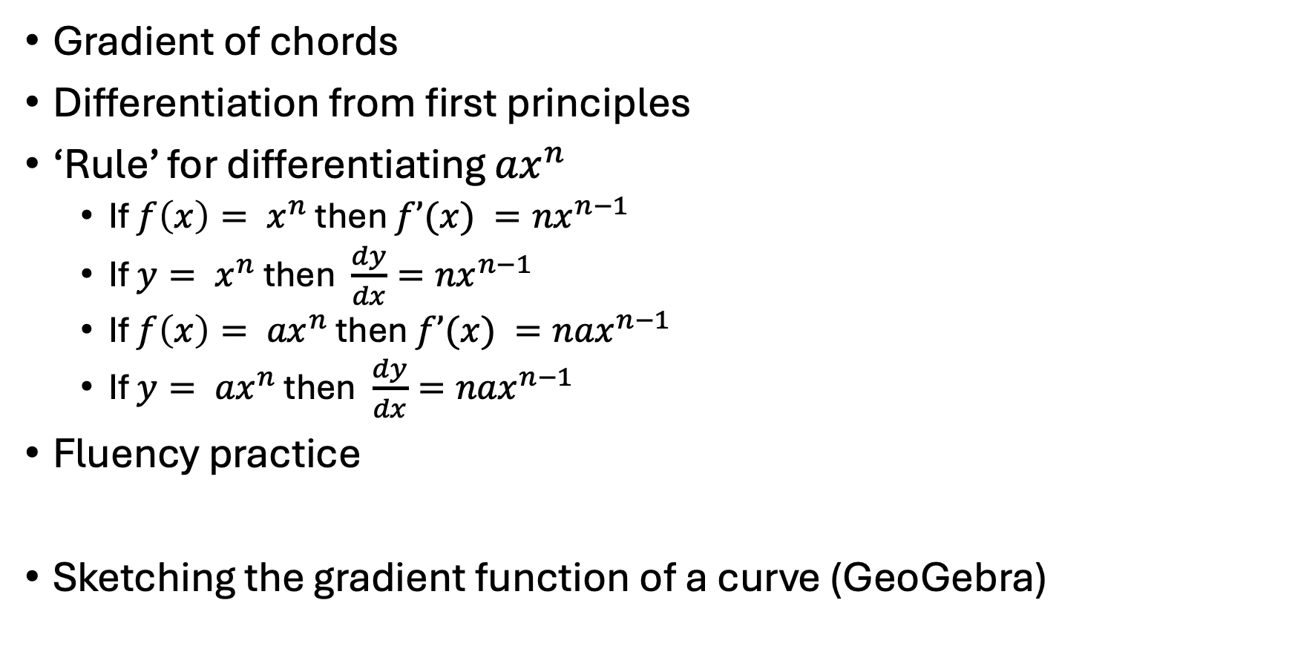
Suggestions for ‘what next’
Gradient of chords
Differentiation from first principles
‘Rule’ for differentiating ${ax}^{n}$
  If $f\left(x\right)= x^{n}$ then $f’(x) ={nx}^{n−1}$
  If $y= x^{n}$ then $\frac{dy}{dx}={nx}^{n−1}$
  If $f\left(x\right)= {ax}^{n}$ then $f’(x) ={nax}^{n−1}$
  If $y= {ax}^{n}$ then $\frac{dy}{dx}={nax}^{n−1}$
Fluency practice
Sketching the gradient function of a curve (GeoGebra)

